Slide 1


Withdrawals – 2 Programme
If a student is on two programmes (e.g. 2 CPDs) and wants to withdraw from one programme only
Warning! Please do not do a Term Withdrawal!!!

Slide 2
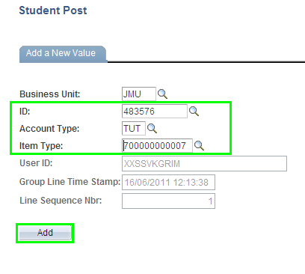
Withdrawals – 2 Programme
Main Menu > Student Financials > Charges and Payment > Post Student Transaction
Enter student number
Choose Tuition (TUT) from Account Type list
Choose 700000000007 Withdrawal Credit from Item Type list

Slide 3
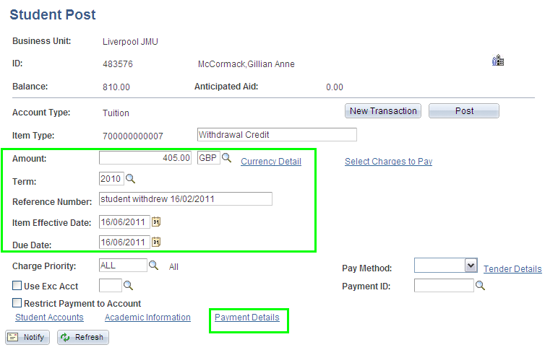
Withdrawals – 2 Programme
Enter Amount to be credited e.g. 405.00
Enter Term 2010
In Reference Number enter free text of when the student withdrew e.g. student withdrew 16/02/2011
Enter the current date in the due date
Click on Payment Details link

Slide 4
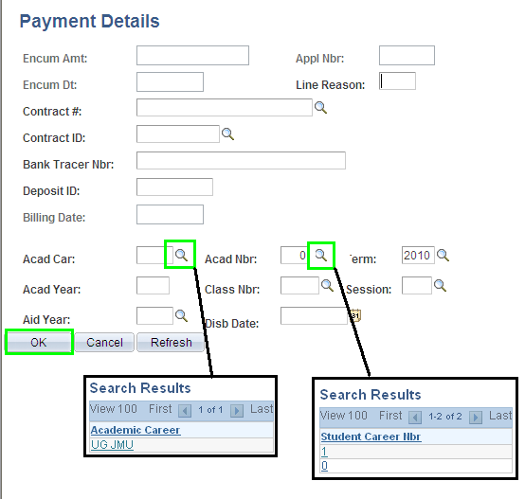
Withdrawals – 2 Programme
Important bit!!!
Click onL against Acad Car and choose UG JMU
Click onL against Acad Nbr and choose which programme the credit should be attributed to (e.g. 1)
Click on OK
You only want to credit one programme….the other prog fee is still valid!!

Slide 5
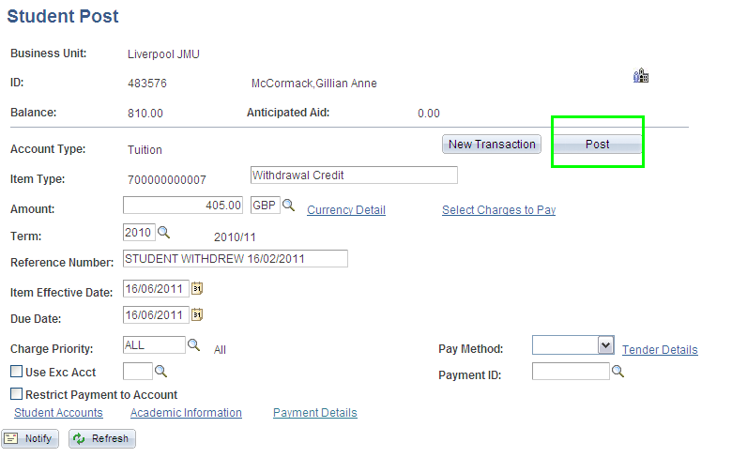
Withdrawals – 2 Programme

