Slide 1

Student Information System
Module 7:
Recording ECs & Assignment Submission
Delivered by Tracey Einig-Jones
Student Records & Academic Advisement
Campus Solutions Implementation Team

Slide 2
Introduction
Module 7 - Key Objectives:
  Understanding the Student Services Center
  Understanding the 3Cs
  Understanding Extenuating Circumstances
  Understanding Assignment Submission
  UPK Session

Slide 3
The Person Lifecycle
Enquire
Apply
Active
Enrol
Study
Progress
Graduate
Recruitment & Admissions
Completion
Learning & Progression
Enrolment

Slide 4
Student Services Centre
Is where both of today’s processes begin.
What is the Student Services Center?
  Provides an Administrative ‘360°’ view of the Student Record
  Also provides Zone and Faculty Admin staff with a view of what the student can see in Student Self Service

Slide 5
Student Services Centre
Information that can be viewed includes:
Summary information
  Academic
  Financial
  Personal
  Admissions
Detailed information
  General Info (Campus Community)
  Admissions (active Applications)
  Transfer Credit (Advance Standing)
  Academics (Student Records)
  Finances and Financial Aid (Student Finance)

Slide 6
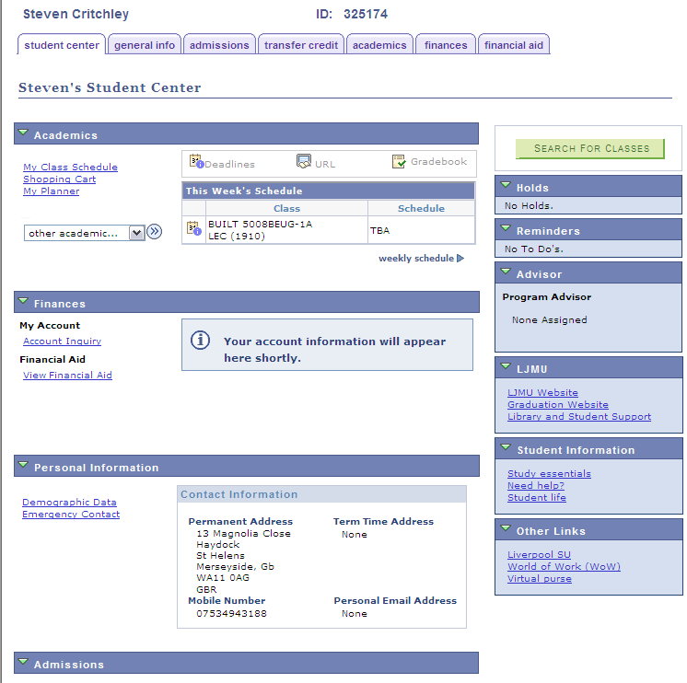
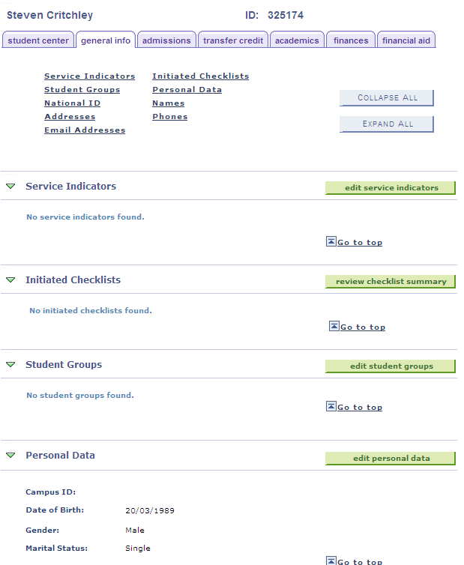
Student Services Centre

Slide 7
Student Services Centre
Another use for the Student Services Centre is to act as a ‘jump in’ point to other places within SIS
This means that navigation around the system is easier as menus and pages don’t have to be remembered

Slide 8
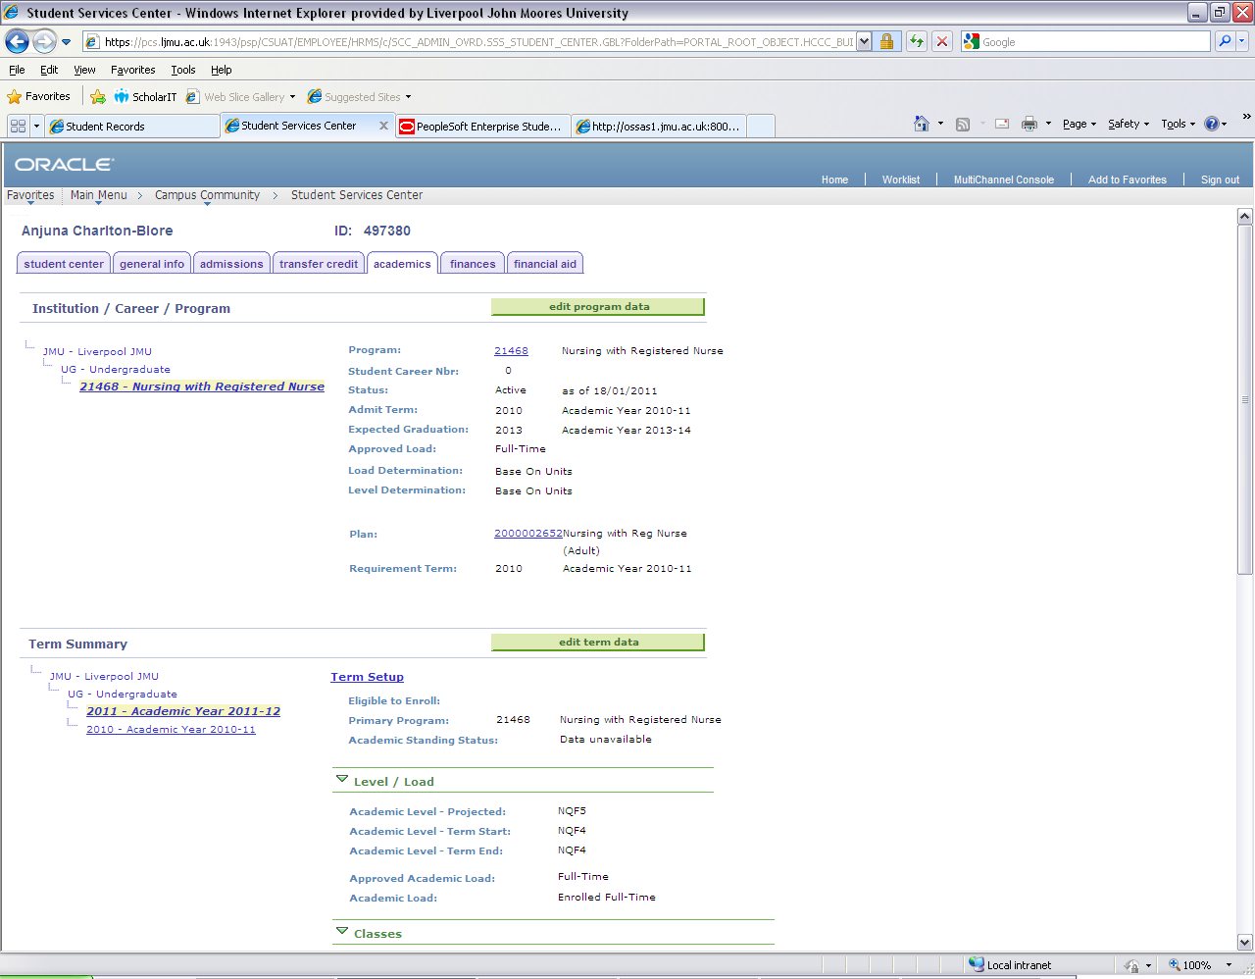
Clicking this button will let you ‘jump’ to the Programme/Plan Stack
Clicking these links will display what Level the student was at and the Courses they were/are enrolled upon

Slide 9
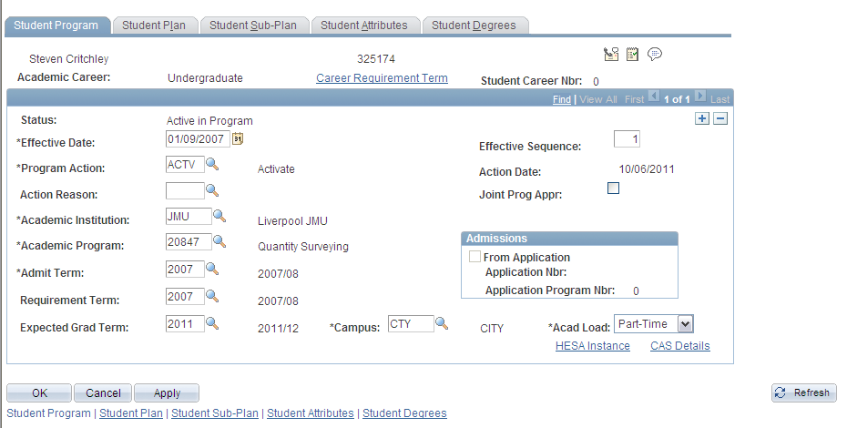
Student Services Centre
We are going to use the button to take us straight to the students Programme data page.

Slide 10
Student Services Centre
    Any Questions?

Slide 11
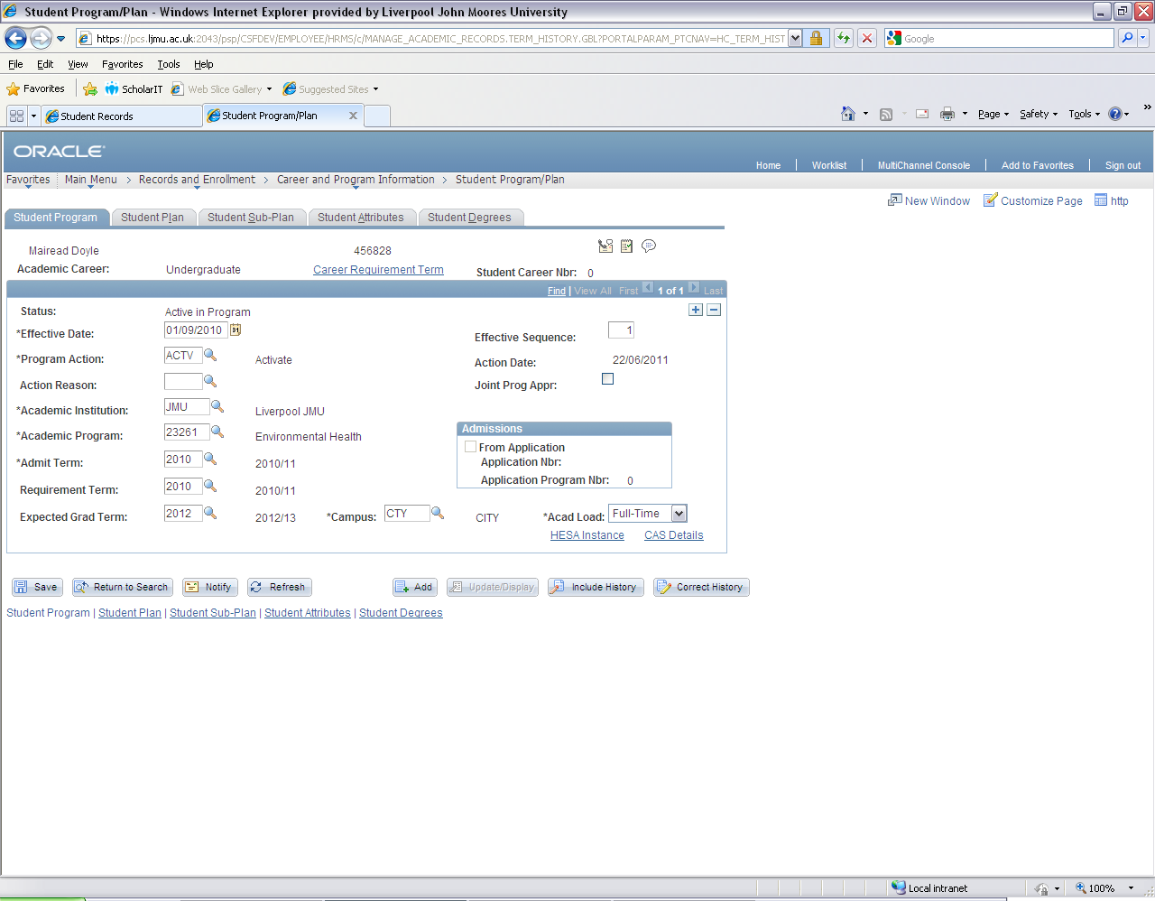
The 3Cs
The 3Cs are Comments, Checklists and Communications
3C access and navigation can be located on many SIS pages

Slide 12
Checklists
3Cs are stored mostly against the Person Details
They can be attached to either a Programme or a Student Term
A person can have many 3C’s attached to them all capturing different activities

Slide 13
Checklists
Provides users with a ‘to ‘do list’ with regard to specific activities
Tracks the ‘when’ and ‘who’ of activities within the Checklist

Slide 14
Extenuating Circumstances
SIS process mirrors and supports the business process
Uses Checklist functionality to record the receipt of a EC form

Slide 15

Extenuating Circumstances
Can record the receipt of a form either through the student Programme details or Campus Community

Slide 16
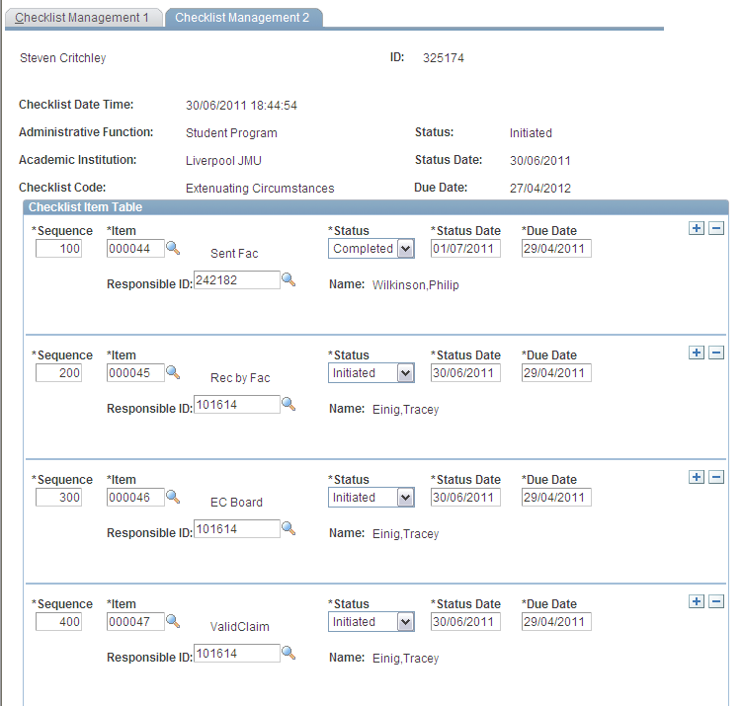
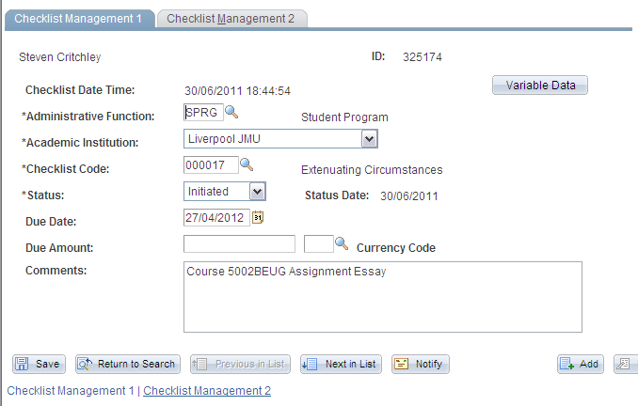

Slide 17
Checklists
    Any Other Questions?

Slide 18
Recording Assignment Submission
SIS can support receipt of Assignments through Gradebook…

Slide 19

Recording Assignment Submission
Yes.. More new terminology!

Slide 20
Gradebook
What is Gradebook?
This is basically a spreadsheet that allows Academic staff to record marks awarded for Summative Assignments and to record basic Feedback

Slide 21
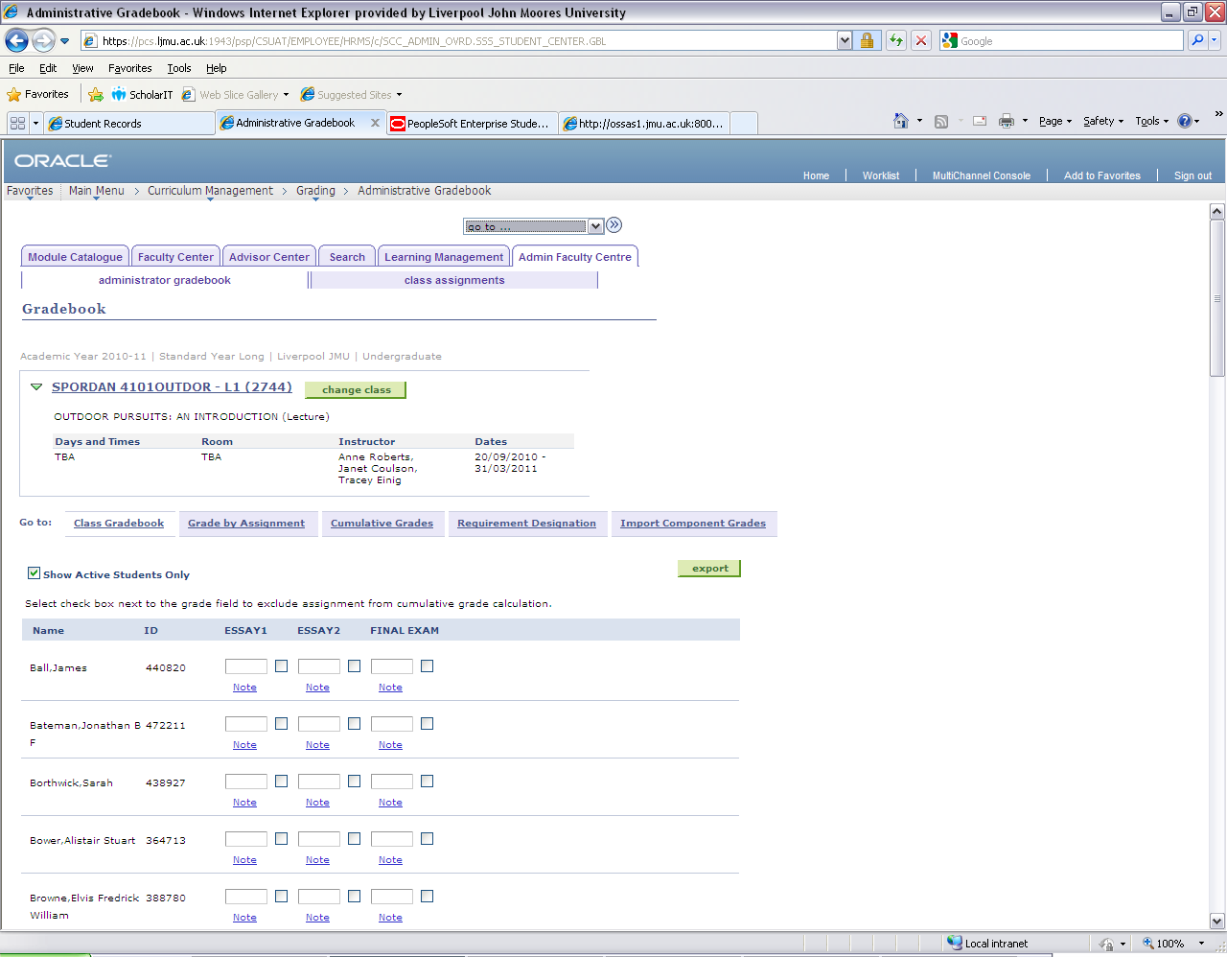
Gradebook

Slide 22
Assignments
What are Assignments?
Assignments are assessments i.e.
      ART - Artefacts
      DISSER - Dissertation
      ESSAY - Essay
      EXAM - Exam
      PORT - Portfolio
      PRAC - Practice
      PRES - Presentation
      REF - Reflection
      RPT - Report
      TECH - Technology
      TEST - Test

Slide 23
Assignments
Summative Assessment:
Where an Assignment mark counts towards the overall Course grade
Assignment Weighting
Not all Assignments need to be equal
      e.g.
        Essay 25%
        Report 25%
        Final Exam 50%
        = Overall Course Grade 100%

Slide 24
Recording Assignment Submission
So, to be able to record when an Assignment was submitted we need to be able to use:
  Gradebook
  Assignments
AND maybe most importantly…

Slide 25
Recording Assignment Submission
Students need to be ENROLLED onto Classes
In fact students need to be ENROLLED onto Classes at the beginning of term.
Not at the end of Term!

Slide 26
Recording Assignment Submission
In essence, we just need to:
    Open Gradebook
    Select the correct Assignment
    Locate the student
    Record the date of Submission
Easy as Pie…

Slide 27
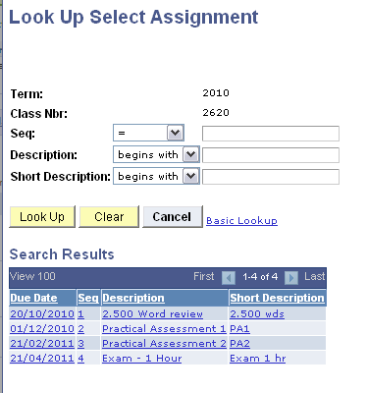
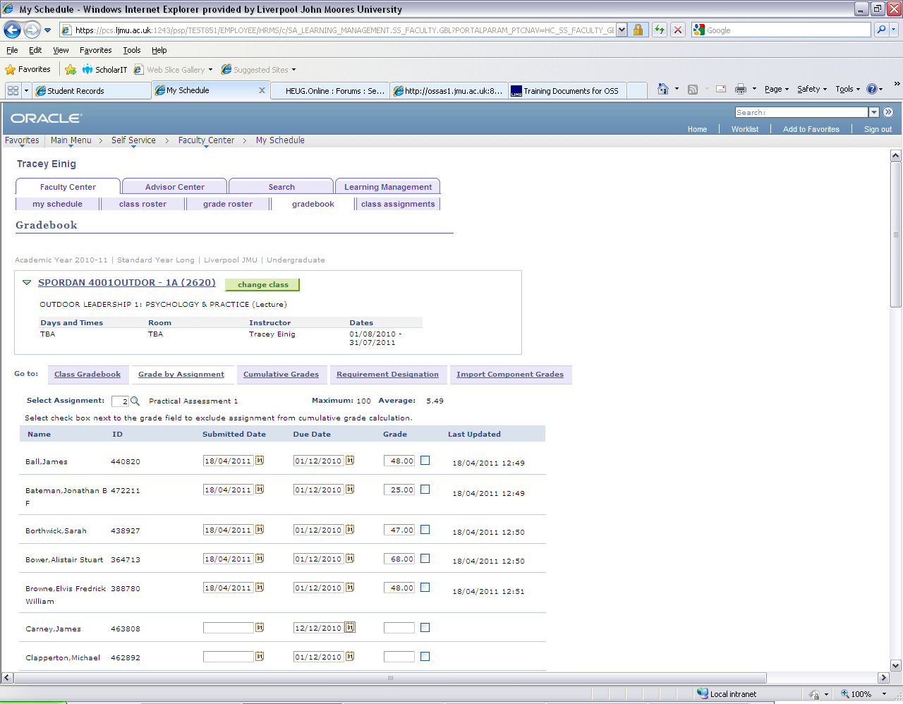
Recording Assignment Submission

Slide 28
Recording Assignment Submission
Once entered assignment submission dates can be viewed by:
  Student Zone staff
  Faculty Admin staff
    though Admin Gradebook or Discoverer Reports
  Academic Staff
    through Faculty Self Service
  and
  Students
    through Student Self Service

Slide 29
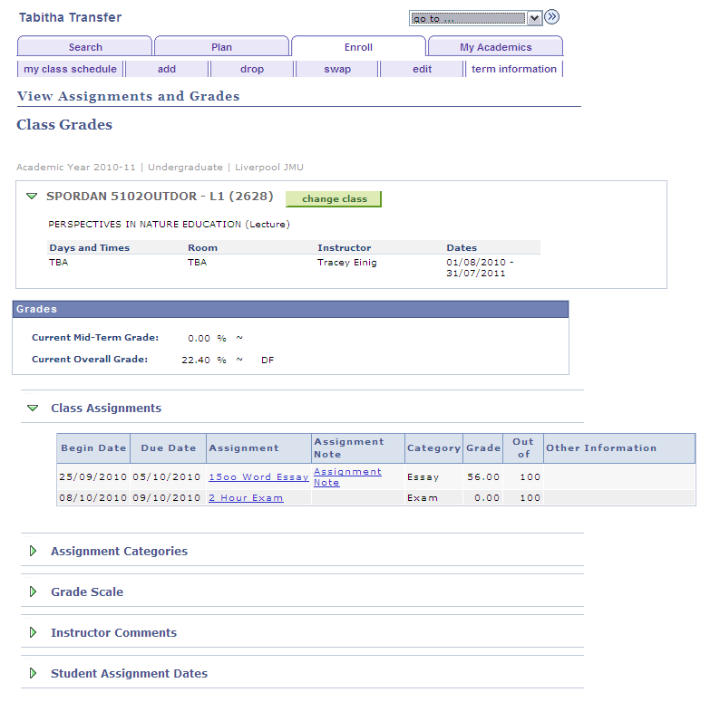
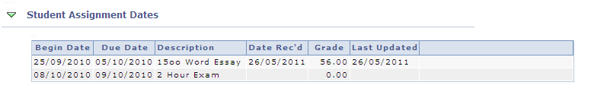
Student Information System

Slide 30
Student Information System
    More Any More Questions?

Slide 31
Student Information System
    Today you will find out…
How to record the receipt of an Extenuating Circumstance Form
How to record the Submission of an Assignment

