Slide 1

Student Information System
Module 3:
Enrolling Students
Delivered by Tracey Einig-Jones
Student Records & Academic Advisement
Campus Solutions Implementation Team

Slide 2
Introduction
Module 3 - Key Objectives:
  Understanding Courses
  Understanding Academic Advisement
  Understanding Classes
  Understanding Enrolment
  UPK Session

Slide 3
Introduction
A few comments...
  There is a lot to learn!
  New terminology – use the Glossary
  If you’re not sure, ask
  There is a lot to learn
  Please, don’t be shy in asking for clarification. We understand.

Slide 4
The Person Lifecycle
Enquire
Apply
Active
Enrol
Study
Progress
Graduate
Recruitment & Admissions
Completion
Learning & Progression
Enrolment

Slide 5
Courses
What is a Course?
A Course is the system name for a Module
Courses are created in the Module Catalogue (ModCat) and are stored in the Course Catalogue

Slide 6
Courses
How is a Course constructed?
    Title
    Subject Area
    E.g. SPORDAN
Course Catalogue number
    E.g. 4012COACH
  First digit = Level

Slide 7
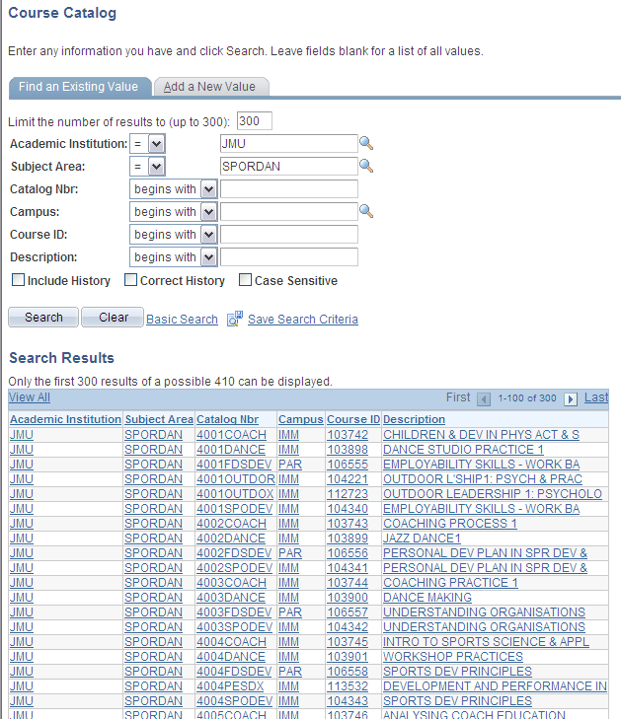
Courses

Slide 8
Courses
How is a Course constructed?
    Owning Details
    Components
  E.g. Lecture, Practical, Seminar, Tutorial, On/Off Site

Slide 9
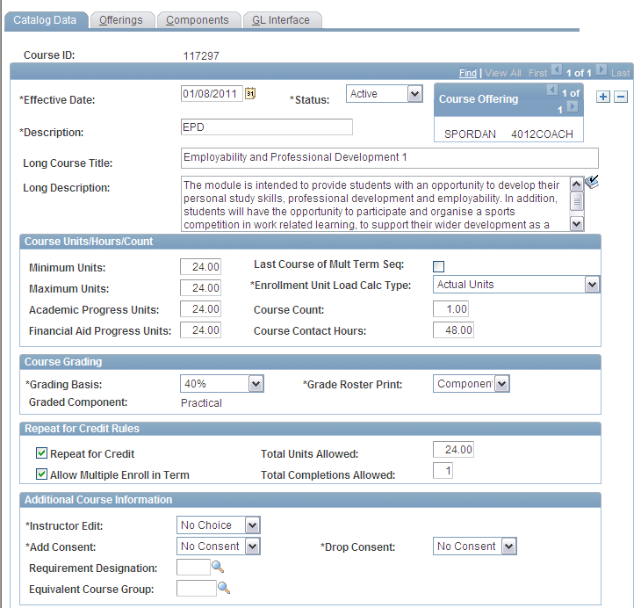
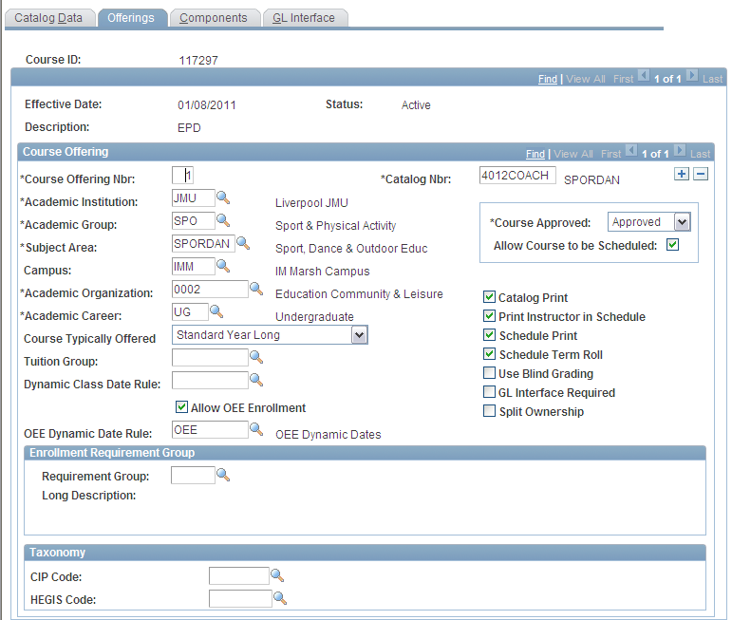
Courses

Slide 10
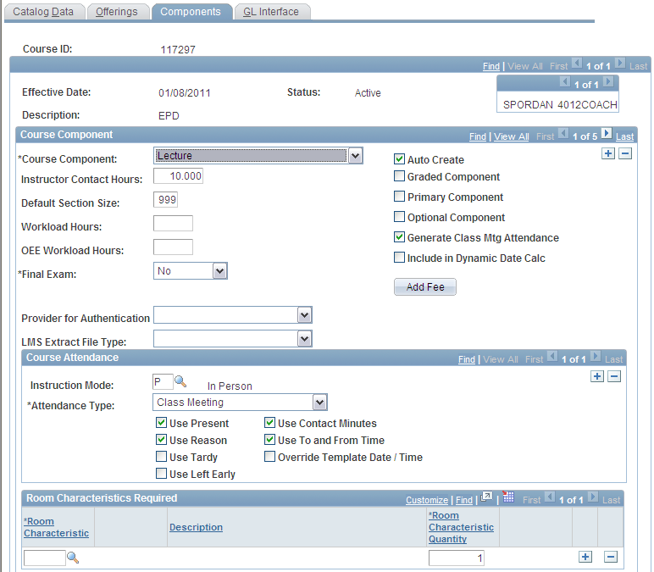
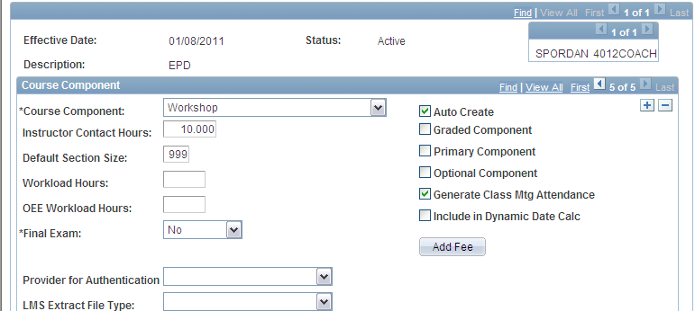
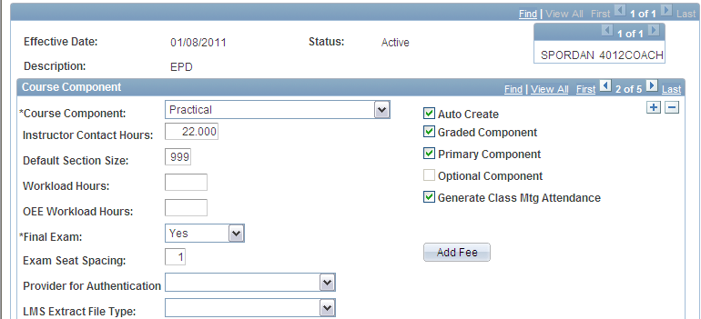



Slide 11
Academic Advisement
Academic What?
    AA holds the programme ‘rules’
    Defines what courses need to be studied at each level.

Slide 12
Academic Advisement
    Controls both progression and enrolment
    Can be viewed at any time by staff AND students via reports
      AAR (Academic Advisement Report)
      Plan (Planning Report)

Slide 13
Academic Advisement
    Quiz question....
    There is another process that AA is used for.
      What is it?
            Answer later...

Slide 14
Classes
    A totally new concept for LJMU
    Helps inform the student timetable
      (future development with S+)

Slide 15
Classes
Course
Title and Nbr
Components
Lec, Pra, Sem, Tut
Class
Offered in 2011, Semester1
Lecture (L1)
ADD
Academic Term
e.g. 2010, 2011
ADD
Session
e.g. S1, Yr, Sum

Slide 16
Classes
    1 class per course component
    Class Section reflects the Class type
      e.g. Lecture = L, Tutorial = T
    Tied together in associated groups
Lecture (L1)
Practical (P1)
Tutorial (T1)
Class Association number: 1

Slide 17
Classes
    1 class is always the Primary class
Lecture (L1)
Practical (P1)
Tutorial (T1)
    This is the class we enrol students onto

Slide 18
Classes
    A Referral class and ESR class are also created (Z classes)
Tutorial (T1)
Practical (P1)
Lecture (L1)
Referral (REF)
ESR (ESR)

Slide 19
Classes
    Remember!!
    A Course
      contains high level module details
    A Class
      Is what a student studies on

Slide 20
Enrolment
    The Enrolment process combines courses, AA and classes
    2 step process
      Planner Filler
      Individual Enrolment

Slide 21
Planner Filler
The Planner is an area that stores Courses that a student would like to study during their next Level (Options).
We add the Cores via an automated process – the Planner Filler.

Slide 22
Enrol by Planner
    Automated Process takes the content of the Planner (cores & options)
    and Enrols the student on the corresponding classes

Slide 23
The Good News
    The Student Admin Team will run both the Planner Filler and Enrol by Planner processes.

Slide 24
The Not So Good News
    Students change their minds!
      They change programme
      They change specialism
      They change options
This is where you come in...

Slide 25
Individual Class Enrolment
    We use a system function called
            Quick Enrol
This allows us to drop and enrol classes individually

Slide 26
Individual Class Enrolment
    First run an AA Plan Report
    This tells us:
      The student’s programme
      Their current level
      What classes they are currently enrolled in
      What classes they can change to

Slide 27
Individual Class Enrolment
    Then drop the unwanted classes
    Finally, enrol the student onto the correct classes

Slide 28
Student Information System
    A Demonstration

Slide 29
Student Information System
    Any Questions?

Slide 30
Student Information System
    Today you will find out…
How to Search for a Course and Class
How to Run an Academic Advisement Report
How to Drop Classes
How to Enrol Classes

