Slide 1

Student Information System
Withdrawals, Student Services Center and LOA
Business Support Office

Slide 2
Introduction
Key Objectives:
  Understanding Withdrawals
  Student Services Center
  Understanding Suspensions & Resumptions

Slide 3
Withdrawals
Process:
Student Zones process all Withdrawal requests

Slide 4
Withdrawals
Use the Student Services Centre to view a students status

Slide 5
Student Services Centre
What is the Student Services Center?
  Provides an Administrative ‘360°’ view of the Student Record
  Also provides Zone and Faculty Admin staff with a view of what the student can see in Student Self Service
  Is where most can processes begin.

Slide 6
Student Services Centre
Information that can be viewed includes:
Summary information
  Academic
  Financial
  Personal
  Admissions
Detailed information
  General Info (Campus Community)
  Admissions (active Applications)
  Transfer Credit (Advance Standing)
  Academics (Student Records)
  Finances and Financial Aid (Student Finance)

Slide 7
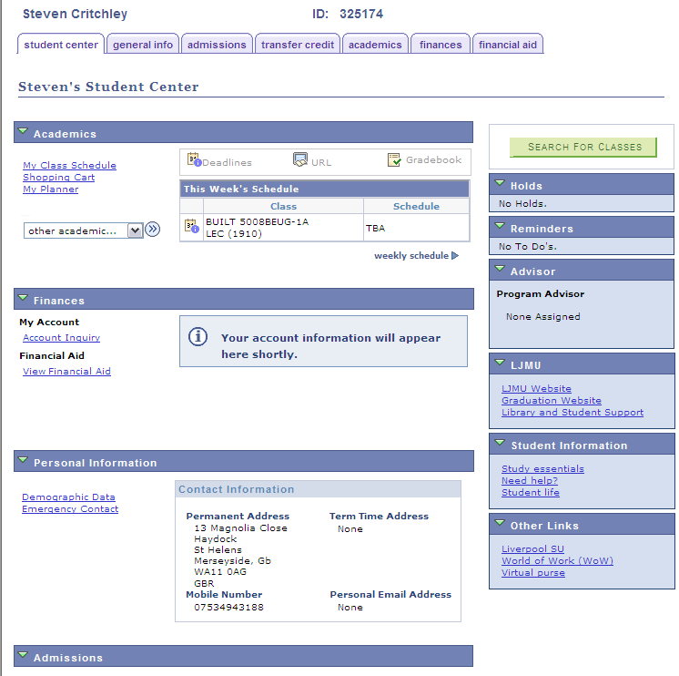
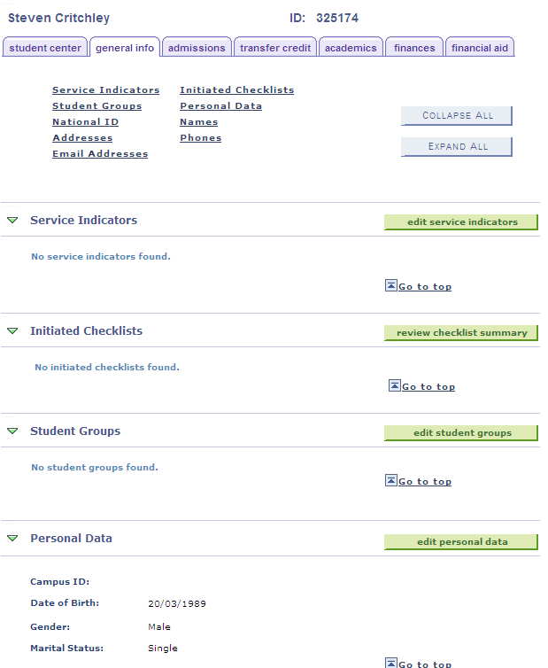
Student Services Centre

Slide 8
Student Services Centre
Another use for the Student Services Centre is to act as a ‘jump in’ point to other places within SIS
This means that navigation around the system is easier as menus and pages don’t have to be remembered

Slide 9
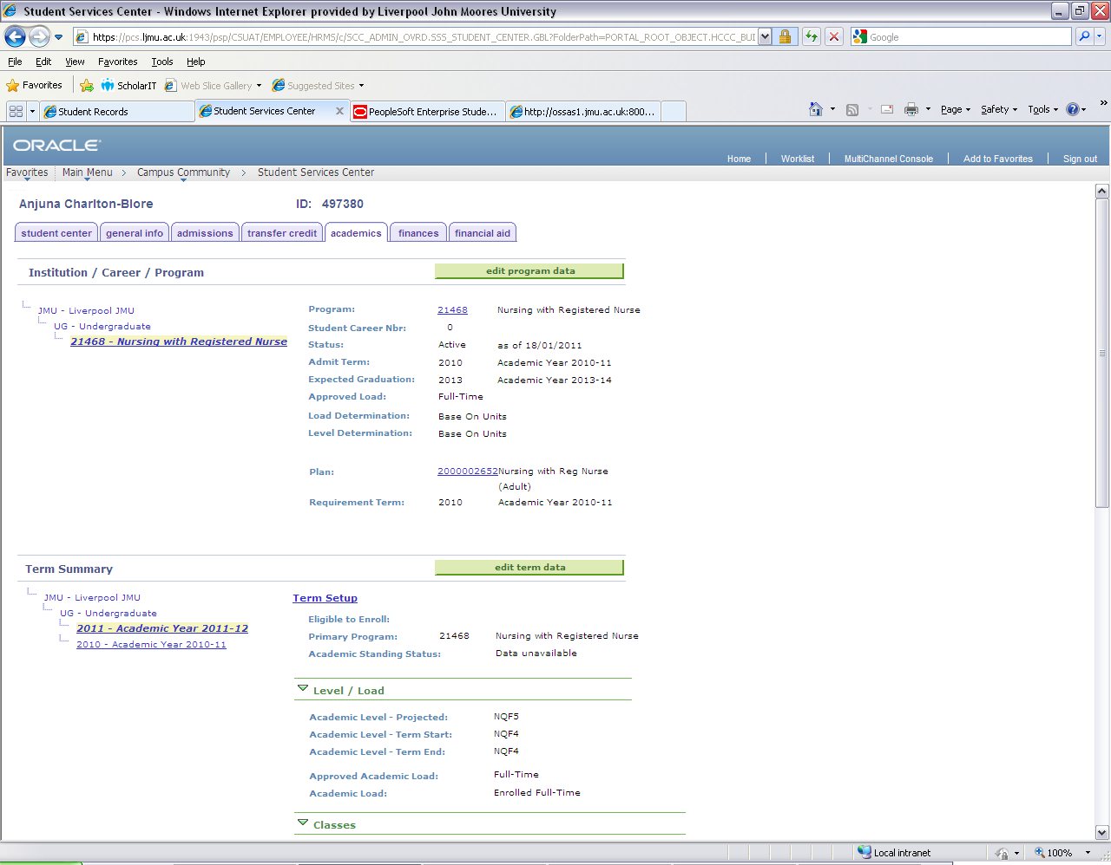
Clicking this button will let you ‘jump’ to the Programme/Plan Stack
Clicking these links will display what Level the student was at and the Courses they were/are enrolled upon

Slide 10
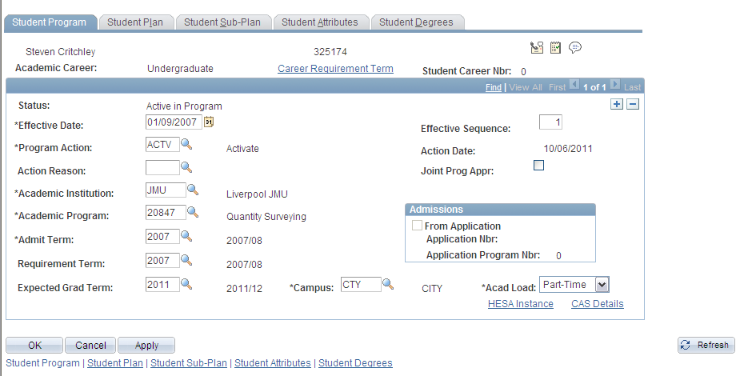
Student Services Centre
We can to use the button to take us straight to the students Programme data page.

Slide 11
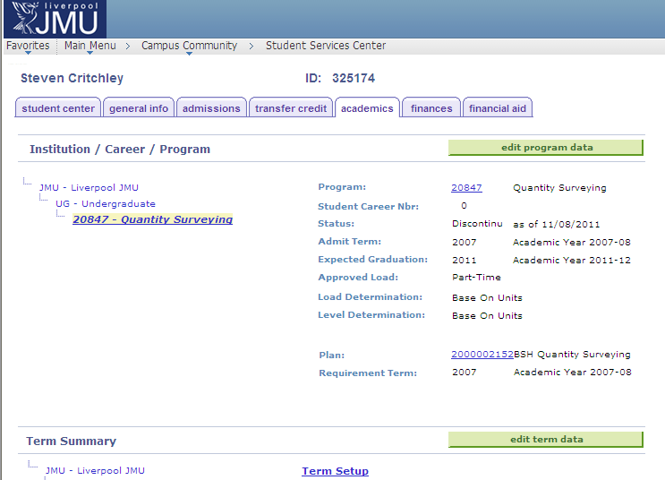
Example Withdrawn Student

Slide 12
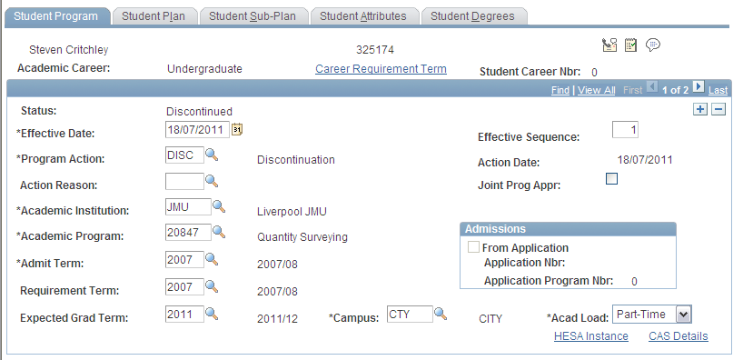
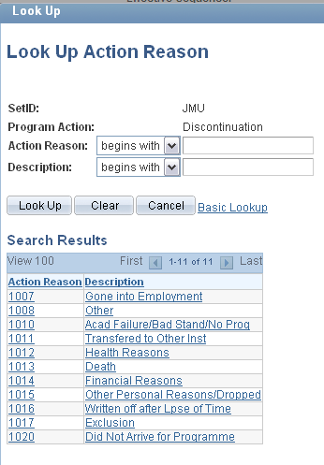
Withdrawal from Programme

Slide 13

Withdrawals
Once saved a Discontinued status CANNOT be undone.
It SHOULDN’T be done from a business process
But in addition, it actually CAN’T be undone, unpicked, amended or overwritten
If in doubt suspend the student and seek further information

Slide 14
Withdrawal Process
So, what happens when a student record is mistakenly discontinued?
  The Admissions Hub for the programme need to ‘re-admit’ the student
  Only then can the modules be re-enrolled. Only current modules need to be enrolled. The graded historical modules will still be part of the students record.

Slide 15
Withdrawals
Any Questions?

Slide 16
Leave of Absence - LOA
Also known as Intermissions
Like Withdrawals we combine Prog/Plan actions with Student Finance process
The Student Zones will process these requests

Slide 17
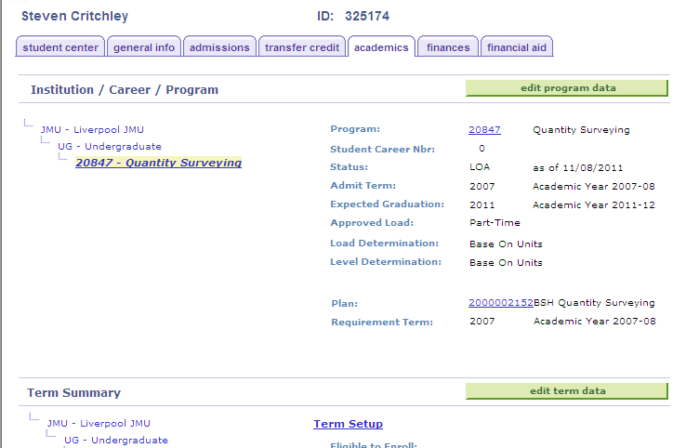
Example LOA Student

Slide 18
Return from Leave of Absence
Another Stack/Finance combo
Student Zones record the action and the date the student actually physically returns to study
and crucially...

Slide 19
Return from Leave of Absence
The student needs to:
Complete the Student Registration Form
Be enrolled on to their Core classes and select/ enrol on their Options
This generates the Fee.

Slide 20
Leave of Absence
Any Questions?

