Slide 1

Student Information System
Module F01:
Student Record Maintenance & Changes
of Circumstance
Presented by Tracey Einig-Jones

Slide 2
Introduction
A few comments...
  There is a lot to learn!
  New terminology – use the Glossary
  If you’re not sure, ask
  There is a lot to learn
  Please, don’t be shy in asking for clarification. We understand.

Slide 3
The Person Lifecycle
Enquire
Apply
Active
Enrol
Study
Progress
Graduate
Recruitment & Admissions
Completion
Learning & Progression
Enrolment

Slide 4
Introduction
Module F01 - Key Objectives:
  Understanding Withdrawals
  Student Services Center
  Understanding Suspensions & Resumptions

Slide 5
Withdrawals
Process:
Student Zones process all Withdrawal requests

Slide 6
Withdrawals
Use the Student Services Centre to view a students status

Slide 7
Student Services Centre
What is the Student Services Center?
  Provides an Administrative ‘360°’ view of the Student Record
  Also provides Zone and Faculty Admin staff with a view of what the student can see in Student Self Service
  Is where most can processes begin.

Slide 8
Student Services Centre
Information that can be viewed includes:
Summary information
  Academic
  Financial
  Personal
  Admissions
Detailed information
  General Info (Campus Community)
  Admissions (active Applications)
  Transfer Credit (Advance Standing)
  Academics (Student Records)
  Finances and Financial Aid (Student Finance)

Slide 9
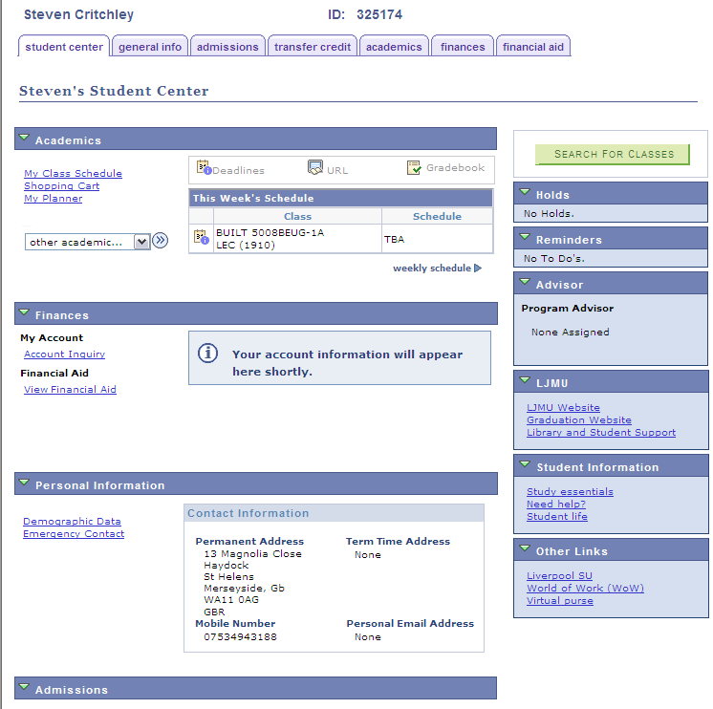
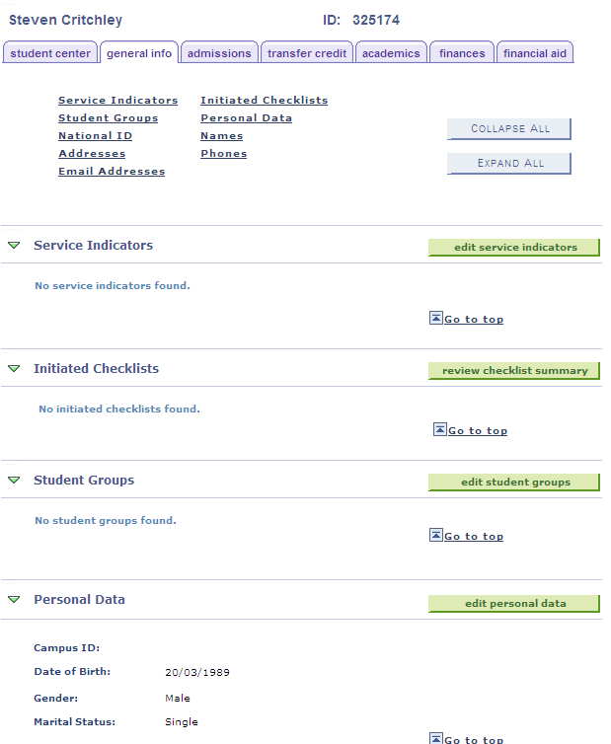
Student Services Centre

Slide 10
Student Services Centre
Another use for the Student Services Centre is to act as a ‘jump in’ point to other places within SIS
This means that navigation around the system is easier as menus and pages don’t have to be remembered

Slide 11
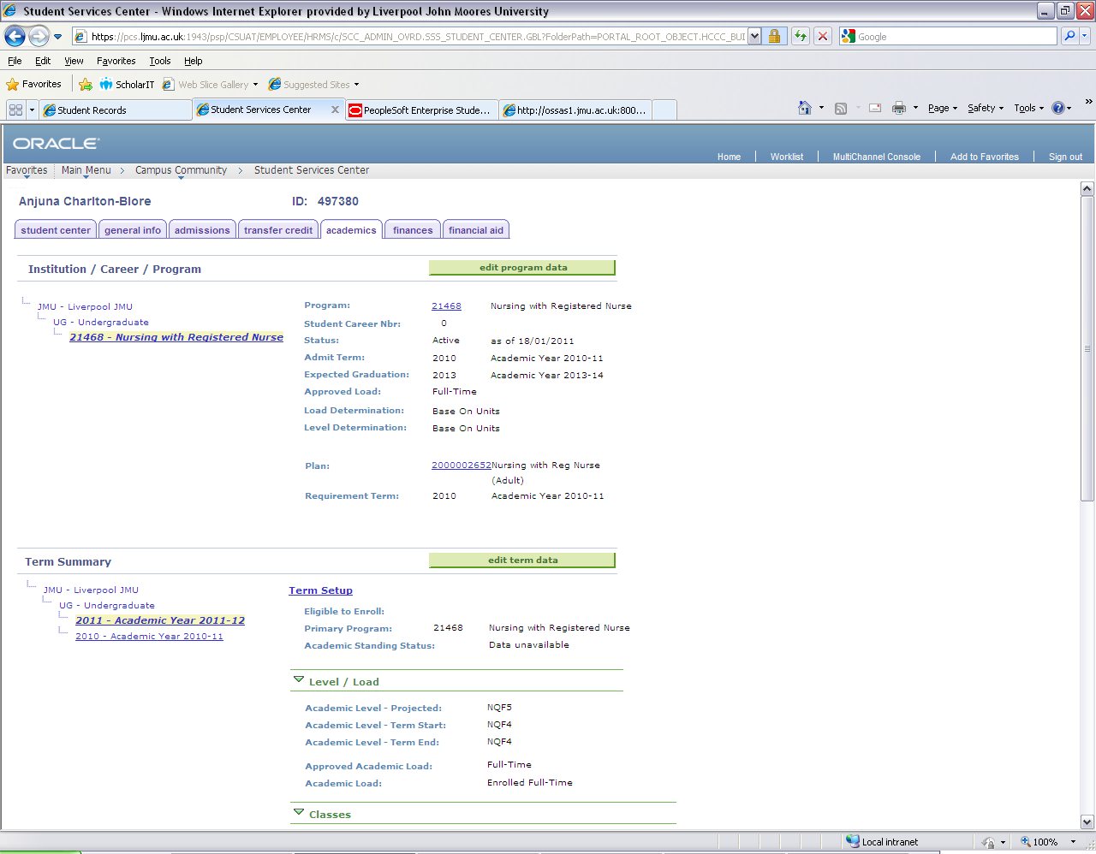
Clicking this button will let you ‘jump’ to the Programme/Plan Stack
Clicking these links will display what Level the student was at and the Courses they were/are enrolled upon

Slide 12
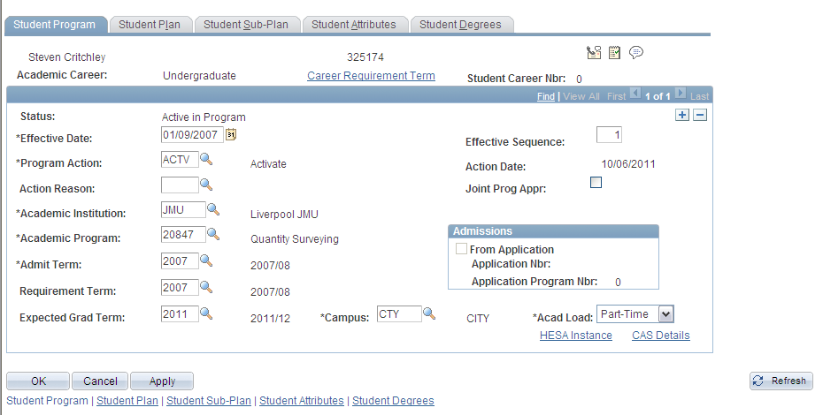
Student Services Centre
We can to use the button to take us straight to the students Programme data page.

Slide 13
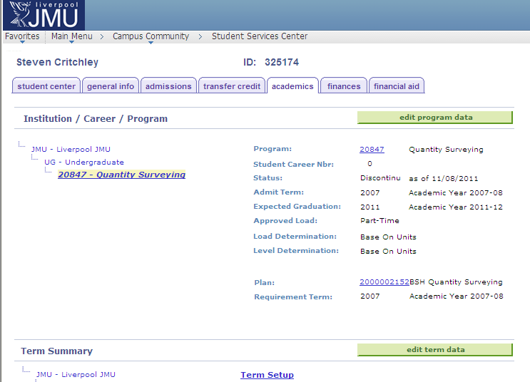
Example Withdrawn Student

Slide 14
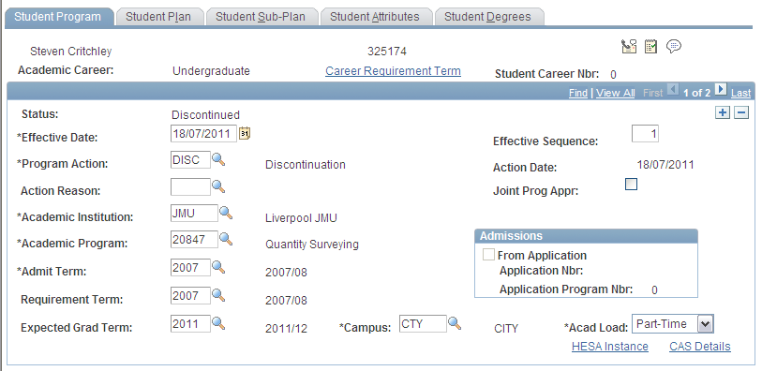
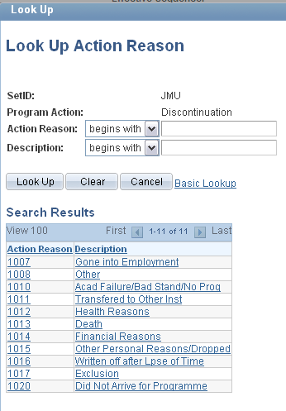
Withdrawal from Programme

Slide 15

Withdrawals
Once saved a Discontinued status CANNOT be undone.
It SHOULDN’T be done from a business process
But in addition, it actually CAN’T be undone, unpicked, amended or overwritten
If in doubt suspend the student and seek further information

Slide 16
Withdrawals
Any Questions?

Slide 17
Leave of Absence - LOA
Also known as Intermissions
Like Withdrawals we combine Prog/Plan actions with Student Finance
The Student Zones will process these requests

Slide 18
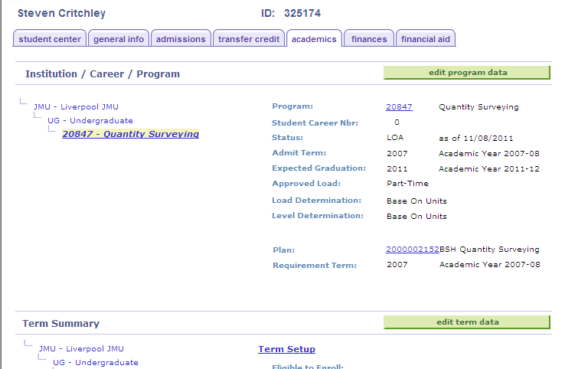
Example LOA Student

Slide 19
Return from Leave of Absence
Another Stack/Finance combo
Student Zones record the action and the date the student actually physically returns to study
and crucially...

Slide 20
Return from Leave of Absence
The student needs to:
Complete the Student Registration Form
Be enrolled on to their Core classes and select/ enrol on their Options
This generates the Fee.

Slide 21
Leave of Absence
Any Questions?

