Slide 1

Student Information System
Module F02:
Student Record Maintenance & Changes
of Circumstance
Brought to you by the Number 6 and the Letter ‘Z’

Slide 2
Introduction
Module F02 - Key Objectives:
  Understanding Programmes and Plans
  Understanding the Programme/Plan Stack
  Understanding Data Changes
  UPK Sessions – Plan Change, Data Change, Programme Change (BUE only)

Slide 3
Programmes
Programmes are…
  …Well… Programmes
  There isn’t really anything special to say about them.
  Except to mention that SIS Programmes are very fond of…

Slide 4


Programmes
This is because in SIS, Programmes are very much like
Umbrellas, ella, ella, eh, eh, eh (sorry!)

Slide 5
Plans
Plans are both…
  Award Aims e.g.
    BA (Hons)
    BA
    DipHE
    CertHE
  Route ways or Specialisms
    Adult Nursing
    Mental Health Nursing
    Child Nursing

Slide 6
Programmes & Plans
Nursing
Programme
BA (Hons)
BA
Child
Plans
Adult
CertHE
The Programme is the umbrella that holds the Plans together.

Slide 7
Programmes & Plans
Any Questions?

Slide 8
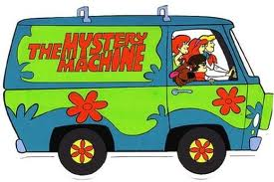
Programmes, Plans & Students
We are starting to understand how SIS is built
But now we need to start to understand the Student Records themselves and how we interact with them
And this is where the ‘Mystery of the Programme/Plan Stack’ comes in...

Slide 9
Programme/Plan Stacks
Career Nbr 0
Career Nbr 1
Programme
Programme
Programme
Programme
Plan
(Award Aim or Routeway)
Plan
(Award Aim or Routeway)
Plan
(Award Aim or Routeway)
Plan
(Award Aim or Routeway)
Term Activation
Level
Modules
Modules
Modules
Modules
Fees

Slide 10
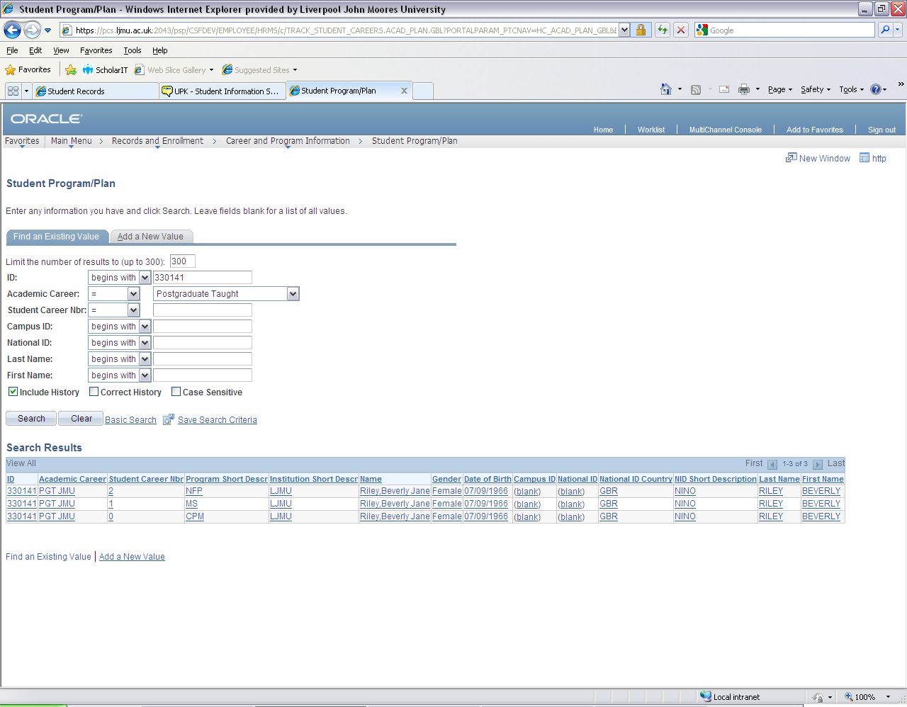
Programme/Plan Stacks
For Example:
This (real) student is currently studying on 3 different Programmes

Slide 11
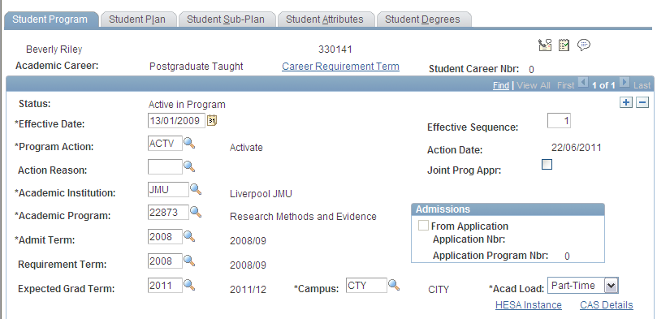
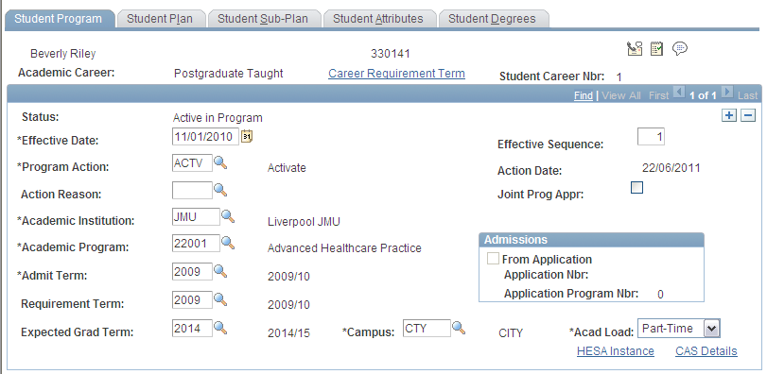

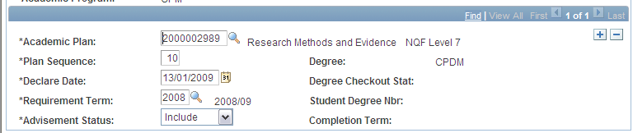


Programme/Plan Stacks

Slide 12
Programme Actions
Programme Actions allow us to build up a history of activity on a Prog/Plan Stack
Some Programme Actions include:
DATA
DISC
LOA
ACTIVATE
RLOA
PLCN
PRGN
COMP

Slide 13
Programme Actions
Of course History is meaningless unless there is an element of time

Slide 14
Effective Dates
Throughout SIS whenever an action is performed, the date the action happened (or is to happen) is recorded
This is an Effective Date

Slide 15
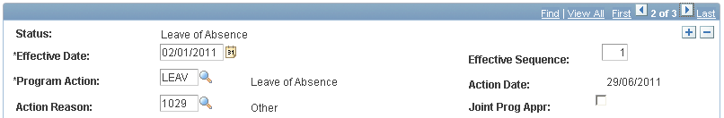
Effective Dates
For each action that is recorded, a new Effected Dated Row is added to the Prog/Plan Stack
For Example, we can see when this student went onto Leave of Absence

Slide 16
Programme/Plan Stacks
So, using a combination of Programme Actions and Effective dates we can understand the story of a students period of study.

Slide 17
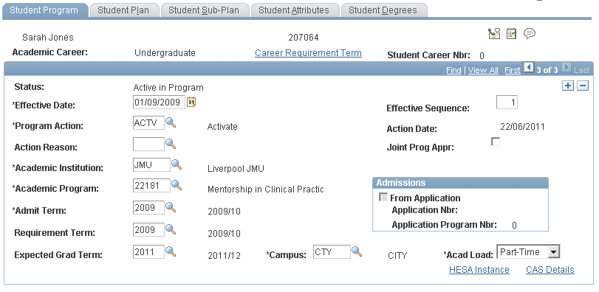
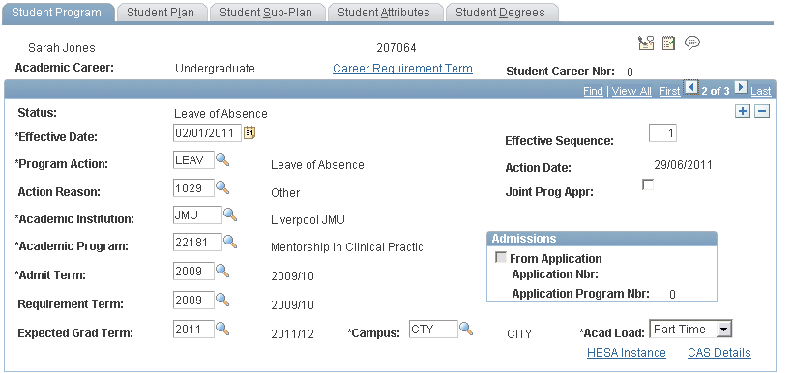
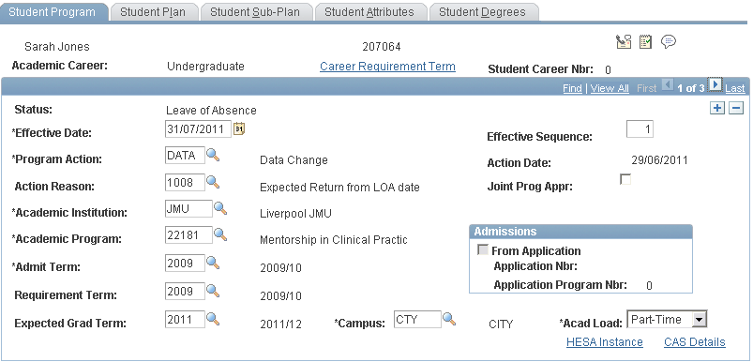
Programme/Plan Stacks

Slide 18
Student Records
In summary all the process today involve the Prog/Plan Stack, Programme Actions and Effective Dates

Slide 19
Programme/Plan Changes
There are two types of Transfer possible in SIS
Plan Change. This allows transfers within the same Programme, so for example an Award Aim change or a change of Routeway.
Programme Change. This occurs when there is a complete change to a new programme of study.

Slide 20
Programme/Plan Changes
Programme/ Plan changes of any type are only to be completed at either:
The beginning of Term (before the Module Registration Deadline date)
or
At the End of Term (as a result of assessment board decisions)
No mid term changes are permissible.

Slide 21
Programme/Plan Changes
Programme Changes are carried out by the Student Zones. This ensures that the Fees are amended correctly.
Plan Changes are carried out by the Faculties. This is because that a Routeway or Award Aim change doesn’t involve a Fee Change

Slide 22
Programme/Plan Changes
Key Principles
June/July – Programme/Plan Changes
The programme/plan change is performed on the student record with a future dated effective date (e.g. 01/08/2011).
Student is advised that the Programme/Plan Change will be active from the future dated row.
September – Programme/Plan Change
Programme/plan changes completed once a new Term has started should be entered with the actual date.
Student is advised that new Programme/plan is now active.

Slide 23
Responsibility Matrix
Scenario | CS process | Responsibility | Notes
Foundation program at JMU to ANY undergraduate program at JMU | Programme Change | Student Zone
Degree programme to ANY degree program | Programme Change | Student Zone
HND in Subject Area X to Degree program in subject X | Programme Change | Student Zone
HND to 2nd Year of degree (and vice versa) | Programme Change | Student Zone | Please see additional notes below ²
Foundation Degree or other programme at Partner Institution to degree at LJMU, if the marks are counting towards the degree classification. | Programme Change | Student Zone
Student transfer from joint honours programme to single or major/minor route | Programme Change | Student Zone | Please see additional notes below ³
Foundation course with NUFC award – (no need to complete) | Programme Change | Student Zone
FT to PT on different programme codes | Programme Change | Student Zone | Check with Andrew if these are multi-plan programmes
Change of Academic Load – FT, PT, SW etc | Data Change | Student Zone
Mphil to Phd | Plan Change | Research Office
Award Aim and or Routeway | Plan Change | Faculty
New ‘multi programme’ | Plan Change | Faculty
Change of other data – exp Grad Term etc | Data Change | Student Zone/Faculty
Foundation program at partner institution to ANY degree at JMU | Re-admission | Admission Hub & Student Zone
HND in Subject Area X to degree program in subject other than X | Re-admission | Admission Hub & Student Zone
Degree to Masters | Re-admission | Admission Hub & Student Zone
Masters to Mphil/Phd | Re-admission | Admission Hub, Research Office & Student Zone | ?
UG Architecture Students returning to do a placement year as part of a Post Grad qualification | Re-admission | Admission Hub
Level X to level 1 | Re-admission | Admission Hub & Student Zone | Please see additional notes below ¹
FT to PT on same programme code | Data Change | Faculty

Slide 24
Data Changes
There are occasions that we need to amend data the sits only on the Prog/Plan Stack e.g.
Expected Graduation Term
Requirement Term (used in Advisement)
Change in Academic Load (FT, PT, SW...)
All we need to do is Add a new Effective Dated row with an action of ‘Data’ (data change).

Slide 25
Data Changes
Examples:
Expected Graduation Term
Requirement Term (used in Advisement)
Can be done by SZ or Faculty
Change in Academic Load (FT, PT, SW...)
Student Zone only

Slide 26
Student Information System
Any Questions?

