Slide 1

Student Information System
Pre-Progression Processing
Business Support Office

Slide 2
Introduction
Key Objectives:
  Understanding Extenuating Circumstances
  Understanding Deferred Attempts
  Understanding Academic Misconduct
  Understanding Posting Grades
  Understanding the Progression and Final Award Mark Calculation Process

Slide 3
Extenuating Circumstances
A student may claim extenuating circumstances when:
timely, severe, acute and unexpected circumstances occur which have significantly affected their performance in module assessment(s) and where the possibility of alternative mitigation is inapplicable or inappropriate.
A student will submit an EC claim after receiving guidance from Student Advice & Wellbeing (SAW).
The form is submitted either:
Within 5 working days of the assessment event as an 'EC',
Or
After that date and before the meeting of the 'EC Panel' as a 'late EC'.

Slide 4
EC Process
  3 part process
  Part One – Local Resolution
    Assignment Extensions
    Assignment Waivers
    Alternative Assignments

Slide 5
EC Process
  Part Two – Student Zones
    Record EC form submitted
    Advise students on services provided by Student Advice and Welfare
    Forward forms to Faculty Offices

Slide 6
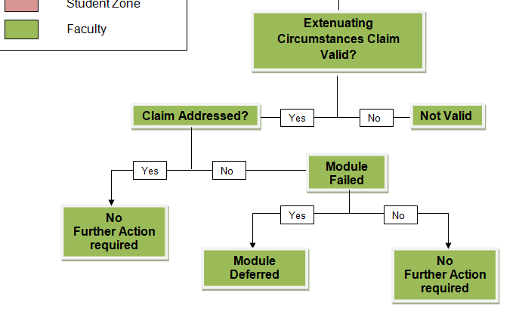
EC Process
  Part Three – Faculty

Slide 7
EC Process
  Recording Receipt of an EC form
    Navigate to: Student Services Centre> General Info page
    Scroll to Initiated Checklists and expand
    Click on Checklist link and go to tab 2
    Record Date received and also Panel date and Outcome

Slide 8
EC Process
  Recording Outcome of an EC claim
    Recorded as a Transcript Note
    Added before Posting Grades on the Grade Roster
    or
    After Posting through Quick Enrol

Slide 9
Transcript Note
  Before Posting Grades
    Navigate to: Main Menu>Curriculum Management>Grade Roster
    Click the Note link
    Select the Note ID
    EC values =
      EC - EC Pending
      NV - EC Not Valid
      NFA - EC Valid. No Further Action
    Click ok, to save the note

Slide 10
Transcript Note
    After Posting Grades
    Navigate to: Main Menu>Records & Enrolment>Enrol Students>Quick Enrol
      Enrolment Action = Norm Maintenance
      Action Reason = TN – Transcript Note update
      Select class
      Click Note link and enter note ID
    Click ok, to save the note
    Submit the Enrolment Request

Slide 11
Deferred Attempts
  The only positive outcome for an EC claim is a Deferral of the attempt – Grade Override value of DEF
  As the student is only postponing the generation of an overall Course grade, this same Course attempt should be used to record both the original ‘deferral’ grade and the actual grade achieved at the next attempt sitting as it ensures that:

Slide 12
Deferred Attempts
The student is not enrolled on a duplicate class
That his attempts at the Course are not compromised (as he has not failed)
That the students fee can be calculated correctly (as there is no charge for a course that has been deferred)
The Progression process and HESA return are calculated correctly
And the changes in the assignment marks, cumulative grade and official grade can all be recorded correctly

Slide 13
Posting Grades
The Posting process ‘finalises’ the overall module grade
Takes place on the Grade Roster
Always ‘partial post’ – this will only post students with grades and not the whole class.
Only ‘post’ when grades have been approved by Academic staff

Slide 14
Progression Process
SIS supports the new Academic Framework
Will ONLY work correctly if:
  Programme and module structures are correct in ProdCat/ModCat
  Student data is correct
  All marks and grades have been entered, approved and posted

Slide 15
Progression Process
Enter Assignment Marks in Gradebook
Enter any Academic Misconduct/ EC Decisions
Run Discoverer Report SR012 – Module Summary report
Meet with Academic staff to approve overall module grade
Make any required assignment mark changes
Repeat steps 3- 5 as necessary
Post all the modules and grades

Slide 16
Progression Process
Run the SIS Progression process
Run Discoverer Report SR013 – Programme Level Summary report
Check output, review students
Make any required adjustments (missing grades etc)
Repeat steps 7- 10 as necessary

Slide 17
Progression Process
Run the SIS Award Mark Calculation process (completing students only)
Run Discoverer Report SR013 – Student Completion Details report
Check output, review students
Go to Board
Carry out Post Board processing

Slide 18
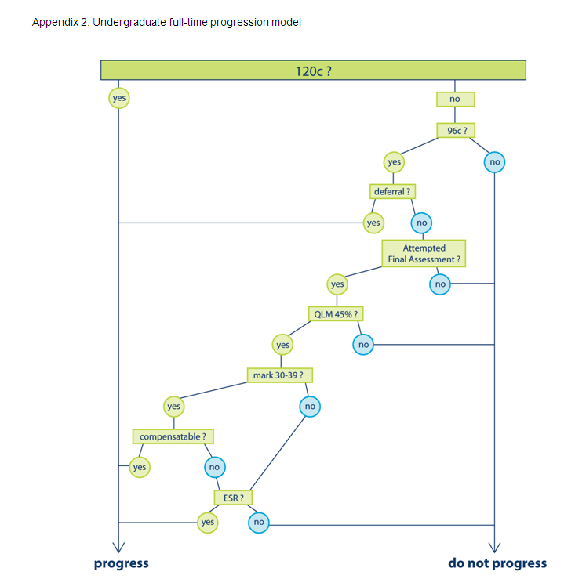

Slide 19
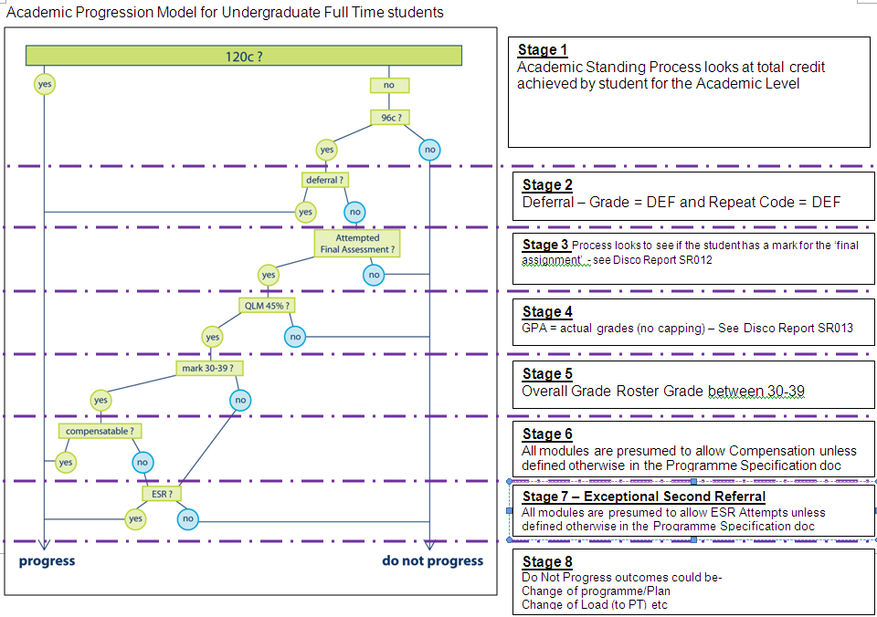

Slide 20
Progression Process
Navigate to: Main Menu>Records & Enrolment>Student Term Information>Term History>Progression Tab
This shows the detail of the process
This same detail is displayed on the Discoverer SR013 reports
Notes:
483708

Slide 21
Compensation
Compensation is applied (mostly) automatically
Navigate to :Main Menu>Records & Enrolment>Student Term Information>Student Grades
The Grading Basis for the student will show that compensation has been applied
If Compensation is not allowed, please check that this is recorded in the Programme Specification
Notes:
515014 2010

Slide 22
Award Mark Calculation Process
Only those students that have successfully completed their Programme will have an Award Mark and Classification calculated
Run Discoverer Report SR013 – Student Completion Details report
Navigate to: Academic Advisement>Student Advisement>Request Advisement Report
Navigate to: Records & Enrolment>Graduation>Graduation Tracking
Notes:
483708

Slide 23
Award Mark Calculation Process
A Note about Transfer Credit
If a Transfer Credit Course is pulling down the Award Mark Calculation –
Unpost the Transfer Credit, add a Repeat Code against the Course of ‘TC’
Repost the Transfer Credit
Notes:
483708

Slide 24
Amending a Posted Grade
All changes to Posted Grades are time stamped with date and time of change and user details
Changes can only be made through Quick Enrol or Enrolment Request
Navigate to: Main Menu>Records & Enrolment>Enrol Students>Quick Enrol
Enrolment Action = Change Grade

Slide 25
Grading Structure
Gradebook
Assignment Marks
Update process
Grade Roster
Overall Module Grade
Grades Posted – once only
Student Module detail
Change Grade – Quick Enrol
Official Student Record

Slide 26
PLN Helpdesk
  Please use the SIS Web Support form to log jobs as the call is immediately categorized and assigned
  If using Helpdesk eMail enter the query summary in the 1st line, e.g. OMR, Assessment Boards, Web Hub reports, etc.
  Escalate any critical jobs in relation to Boards via Business Support Manager – email l.m.godfrey@ljmu.ac.uk
Notes:
5001BAANUR

