Slide 1

Student Information System
Module F03:
Transfer Credit
Delivered by Tracey Einig-Jones
Business Support Office
Planning & Information

Slide 2
Introduction
Module 3 - Key Objectives:
  Understanding Transfer Credit
  Understanding Course Credits
  Understanding Other Credits
  Understanding Courses

Slide 3
Transfer Credit
Transfer Credit is the SIS term for Advance Standing
Transfer Credit is also known as Accreditation for (Experiential) Prior Learning or AP(E)L

Slide 4
Transfer Credit
Transfer Credit is:
The process by which Credit gained from other Institutions - APL
Certain Work/Life Experiences can also count towards a named Award here at LJMU - APEL

Slide 5
Transfer Credit
CERTIFICATED PRIOR LEARNING/ CREDIT TRANSFER.
This is previous learning undertaken in the University or elsewhere for which qualifications or certificates have been granted.
The prior learning must be recent, normally within five years, and relevant
Course Credit (APL)

Slide 6
Transfer Credit
UNCERTIFICATED PRIOR LEARNING/ EXPERIENTIAL LEARNING
This is where the prior learning is un-certificated, that is, learning gained through activities such as paid work, leisure pursuits or voluntary work
Other Credit (APEL)

Slide 7
Transfer Credit
Transfer Credit is SIS can be applied as either:
A ‘block’ of Credit
  e.g. where a Levels worth of credit is to be applied
A course by course basis
  e.g. where identified modules can be matched to existing LJMU courses

Slide 8
Transfer Credit
In addition:
Credit can count towards the ‘Grade Point Average’
  e.g. grades count towards to final Award Mark for the student
Credit can be recorded without it counting towards ‘GPA’
  e.g. where a record of previous achievement needs to be recorded

Slide 9
Transfer Credit
Any Questions?

Slide 10
Courses
What is a Course?
A Course is the system name for a Module
Courses are created in the Module Catalogue (ModCat) and are stored in the Course Catalogue

Slide 11
Courses
How is a Course constructed?
    Title
    Subject Area
    E.g. SPORDAN
Course Catalogue number
    E.g. 4012COACH
  First digit = Level

Slide 12
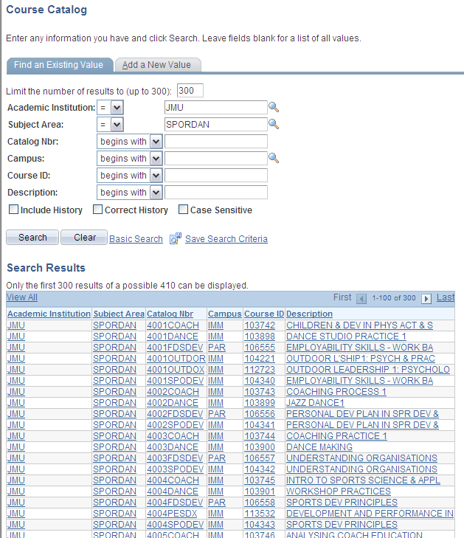
Courses

Slide 13
Courses
How is a Course constructed?
    Owning Details
    Components
  E.g. Lecture, Practical, Seminar, Tutorial, On/Off Site

Slide 14
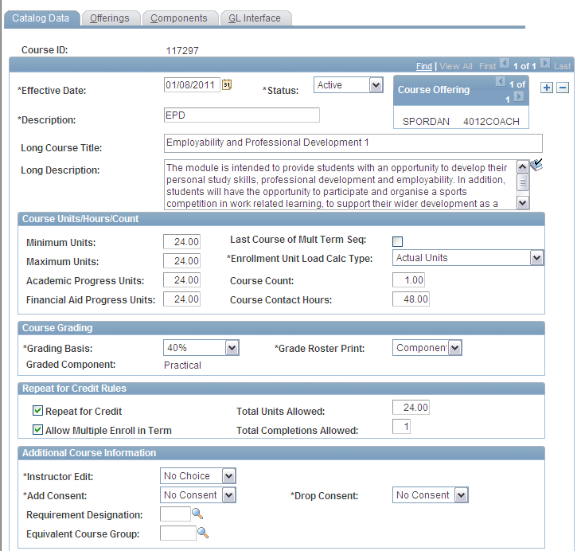
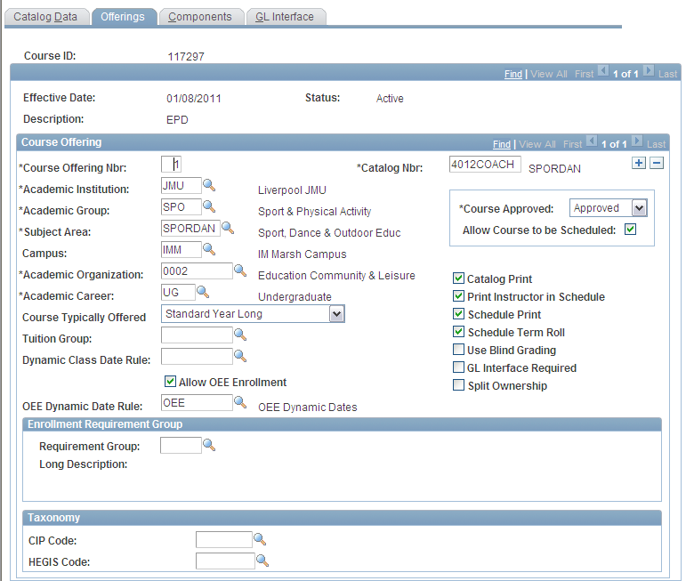
Courses

Slide 15
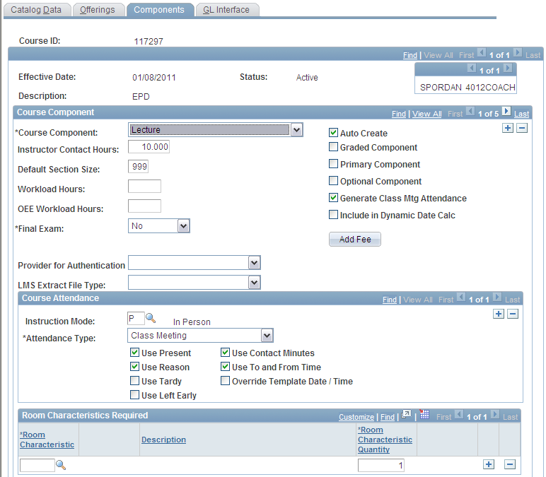
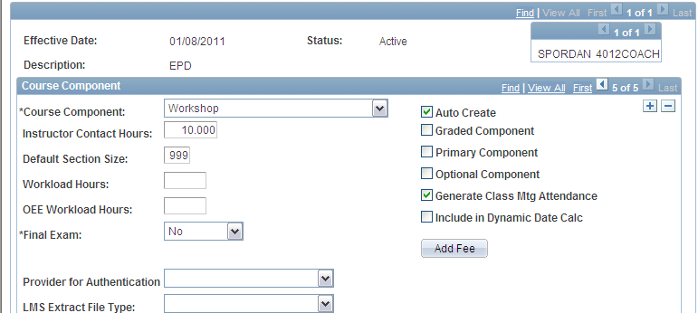
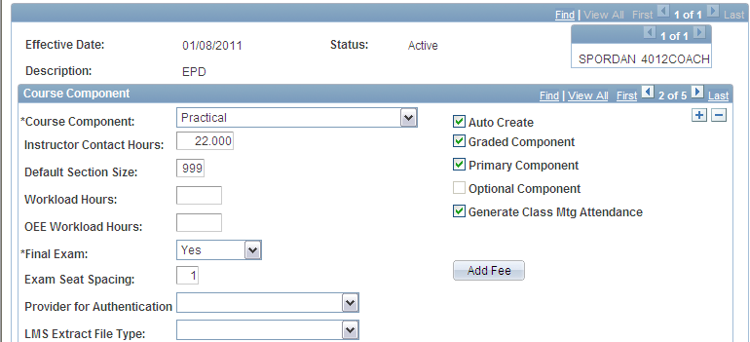



Slide 16
Transfer Credit & Courses
Where ‘blocks’ of Credit is being recorded
SIS uses its own set of Courses
This also includes a dedicated Subject Area and a Grade Basis

Slide 17
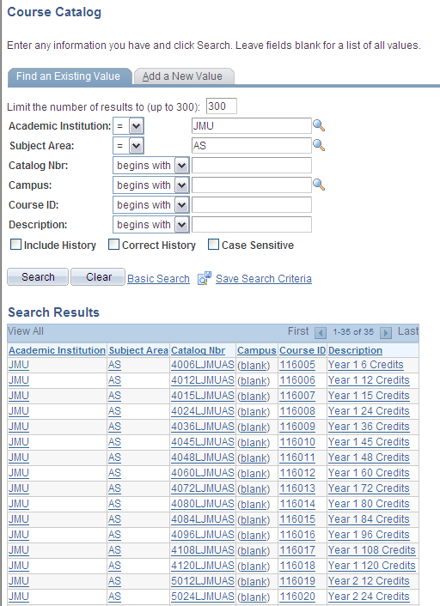

Slide 18
Student Information System
Important Note:
Where records have missed the OSS to SIS migration (for whatever reason) a new application needs to be entered by the Admissions Hub
Transfer Credit can then be entered for the ‘missing’ Academic History for the Programme – by module – not block credit!

Slide 19
Student Information System
    Any Questions?

