Slide 1

Student Information System
Additional Information
Campus Solutions Implementation Team

Slide 2
Introduction
Key Objectives:
  Understanding the Calendar Structure
  Understanding the Programme and Course Structure
  Understanding Careers and Academic Levels
  Understanding Term Activation

Slide 3
Calendar Structure
University Calendar
Academic Year
Summer
Semester 1
Semester 2
Aug
Sep
Oct
Nov
Dec
Jan
Feb
Mar
Apr
May
Jun
Jul
OSS Calendar
Acad_STD
Acad_S2
Non_Std
Summer
Semester 1
Semester 2
Aug
Sep
Oct
Nov
Dec
Jan
Feb
Mar
Apr
May
Jun
Jul
Calendars
Sessions

Slide 4
Calendar Structure
University Calendar
Academic Year
Summer
Semester 1
Semester 2
Aug
Sep
Oct
Nov
Dec
Jan
Feb
Mar
Apr
May
Jun
Jul
SIS Calendar
Academic Year
Summer
Semester 1
Semester 2
Year Long
2 Yr Long
Aug
Sep
Oct
Nov
Dec
Jan
Feb
Mar
Apr
May
Jun
Jul
Calendars
Sessions

Slide 5
Programme and Courses
Academic Structure
Academic Advisement
Student Data
New Module
Institution
Programme
Plan
Course Catalogue
Programme
Plan
NQF4
Course 1 Core
Course 2 Core
Course 3 Core
Course 4 Core
Course 5 Core
Course 6 Core
NQF5
Course 1 Core
Course 2 Core
Course 3 Core
Course 4 Core
Course 5 Option
Course 6 Option
NQF6
Course 1 Core
Course 2 Core
Course 3 Option
Course 4 Option
Course 5 Option
Course 6 Option
Active on Career
Programme
Plan
Module Catalogue
Student Advisement Report
Validated & Approved
Enrolled on Classes
Programme Catalogue
Within SIS
New Programme/Plan
Outside SIS

Slide 6
Careers & Levels
Career
Careers:
Undergraduate
Postgraduate Taught
Postgraduate Research
Undergrad Non UMF
Postgrad Non UMF
WoW
Programme
Programme
Plan
(Award Aim or Routeway)
Plan
(Award Aim or Routeway)
Term Activation
Level
Academic Levels:
NQF3 - Foundation
NQF4 – Level 1 UG
NQF5 – Level 2 UG
NQF6 – Level 3 UG
NQF7 – Level M PGT
NQF8 - PGR
Modules
Fees

Slide 7
Term Activation
Term Activation is the process by which we base class enrolments and fee calculations for a students Academic Year – it is the indicator by which we know a student has ‘arrived’ to commence their studies
Students Level detail is also calculated on a Term by Term basis
The students Primary programme is also displayed. The Primary programme is the lowest number (e.g. 0) in the students Programme/Plan Stack

Slide 8
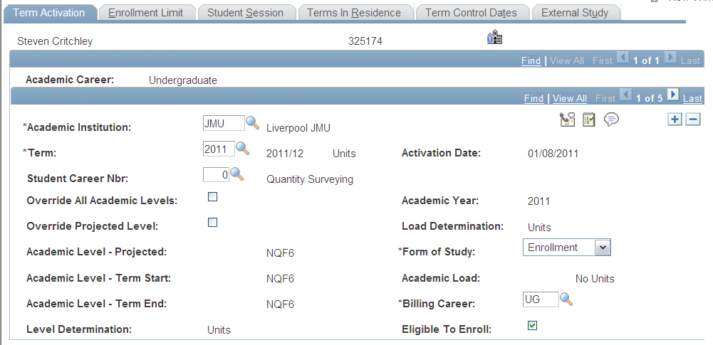

Term Activation

Slide 9
Term Activation
A student is only activated in a Term (by a batch process) when they have completed the Student Registration form

