Slide 1

Student Information System
Enrolment Process
Business Support Office

Slide 2
Introduction
Key Objectives:
  Understanding Academic Advisement
  Understanding Enrolment

Slide 3
The Enrolment Process
Student completes Student Registration
Student is recorded in SIS as being ‘active’ in the 2011 Term
Academic Advisement provides the Programme and Course structure
Students are enrolled on classes

Slide 4
Academic Advisement
Academic What?
    Academic Advisement is the validated Programme content.
    AA holds the programme ‘rules’
    Defines what courses need to be studied at each level

Slide 5
Academic Advisement
    Controls both student progression and enrolment
    Can be viewed at any time by staff AND students via reports
      AAR (Academic Advisement Report)
      Plan (Planning Report)

Slide 6
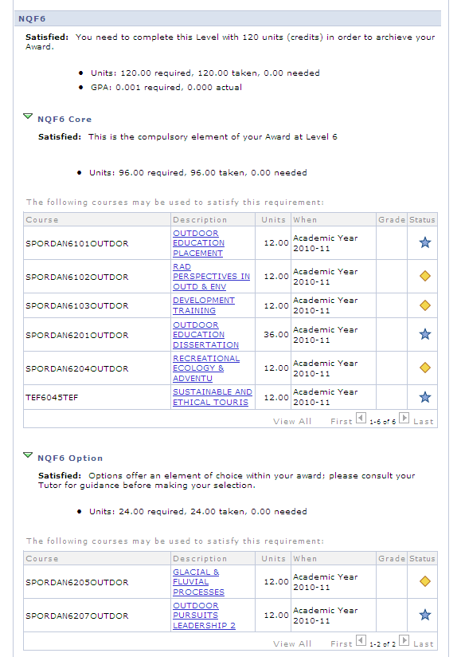

Slide 7
Enrolment
    The Enrolment process combines courses, AA and classes
    2 step process
      Planner Filler
      Individual Enrolment

Slide 8
Planner Filler
The Planner is an area that stores Courses that a student would like to study during their next Level (Options).
We add the Cores via an automated process – the Planner Filler.

Slide 9
Enrol by Planner
    Automated Process takes the content of the Planner (cores & options)
    and Enrols the student on the corresponding classes

Slide 10
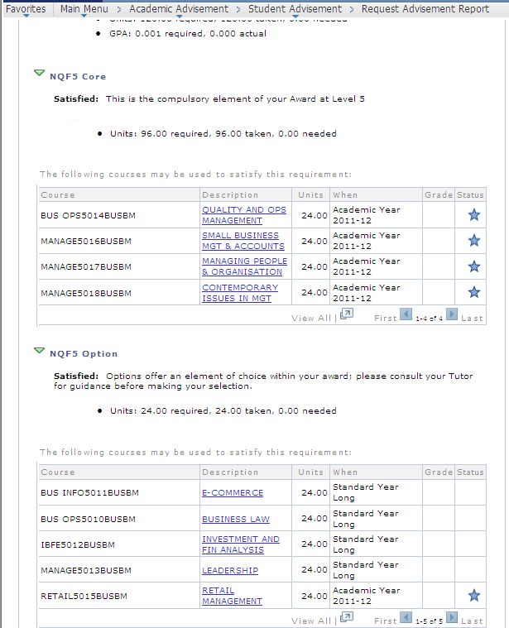

Slide 11
The Good News
    The SIS Team will run both the Planner Filler and Enrol by Planner processes
    This means that the majority of the Course (module) enrolments will be automatically loaded

Slide 12
The Not So Good News
    Students change their minds!
      They change programme
      They change specialism
      They change options
This is where Individual Enrolment comes in...

Slide 13
Individual Class Enrolment
    We use a system function called
            Quick Enrol
This allows staff to drop and enrol classes individually

Slide 14
Class Lists
    Class Lists – produced once students have been enrolled on Classes
    Admin staff can create Class Lists
    As can Academic staff, through the Academic Self Service
    Student Zone staff can also produce Class Lists

Slide 15
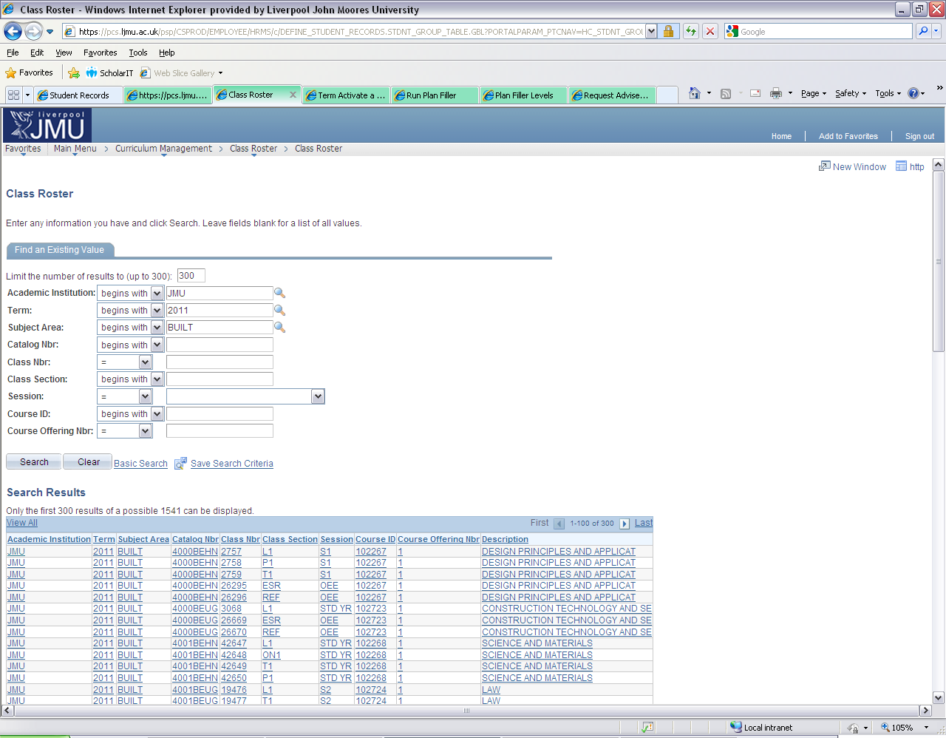

Slide 16
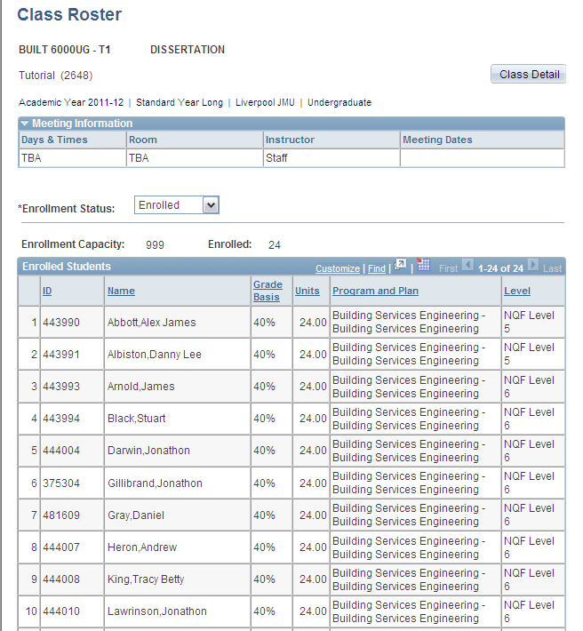

Slide 17
Student Information System
    Any Questions?

