Slide 1

Student Information System
Module 1:
Enrolling Students
Delivered by Tracey Einig-Jones
Business Support Office
Planning & Information

Slide 2
Introduction
Module 1 - Key Objectives:
  Understanding Courses and Classes
  Understanding Academic Advisement
  Understanding Enrolment
  UPK – Producing Class Lists

Slide 3
Courses & Classes
Courses are Modules
Courses consist of Components
  = Teaching Delivery eg Lecture, Tutorial, Practical etc
Classes are scheduled Components
  For example:
  Lecture is on Monday at 10am
  Tutorial is on Thursday at 4pm
Students study on Classes

Slide 4
The Enrolment Process
Student completes Student Registration
Student is recorded in SIS as being ‘active’ in the 2011 Term
Academic Advisement provides the Programme and Course structure
Students are enrolled on classes

Slide 5
Academic Advisement
Academic What?
    AA holds the programme ‘rules’
    Defines what courses need to be studied at each level

Slide 6
Academic Advisement
    Controls both progression and enrolment
    Can be viewed at any time by staff AND students via reports
      AAR (Academic Advisement Report)
      Plan (Planning Report)

Slide 7
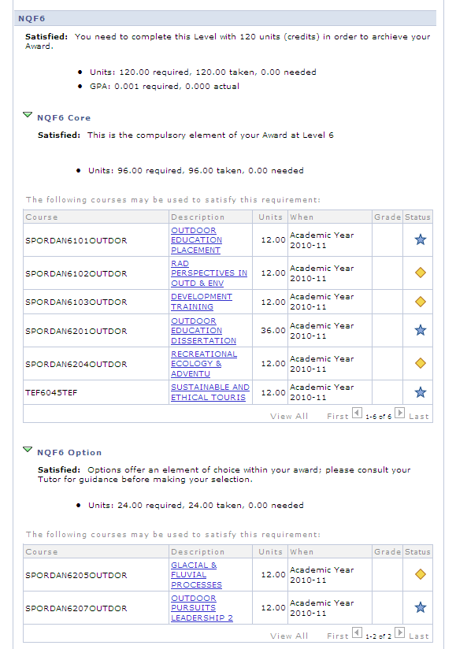

Slide 8
Enrolment
    The Enrolment process combines courses, AA and classes
    2 step process
      Planner Filler
      Individual Enrolment

Slide 9
Planner Filler
The Planner is an area that stores Courses that a student would like to study during their next Level (Options).
We add the Cores via an automated process – the Planner Filler.

Slide 10
Enrol by Planner
    Automated Process takes the content of the Planner (cores & options)
    and Enrols the student on the corresponding classes

Slide 11
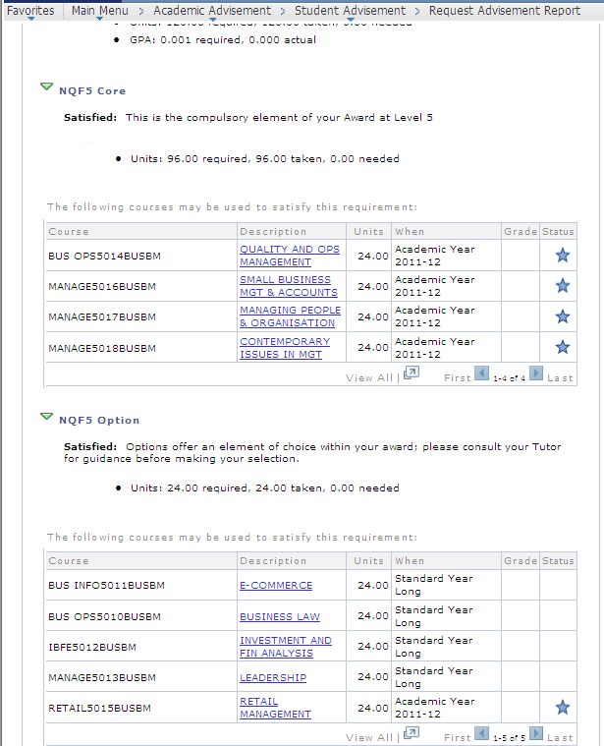

Slide 12
The Good News
    The SIS Team will run both the Planner Filler and Enrol by Planner processes
    This means that the majority of the Course (module) enrolments will be automatically loaded

Slide 13
The Not So Good News
    Students change their minds!
      They change programme
      They change specialism
      They change options
This is where Individual Enrolment comes in...

Slide 14
Individual Class Enrolment
    We use a system function called
            Quick Enrol
This allows the Student Zones to drop and enrol classes individually

Slide 15
Individual Class Enrolment
    The last date for changes to enrolled Option choices is
    MRD – Module Registration Deadline
    7th October 2011

Slide 16
Class Lists
    Class Lists – produced once students have been enrolled on Classes
    Admin staff can create Class Lists
    As can Academic staff, through the Academic Self Service
    Student Zone staff can also produce Class Lists

Slide 17
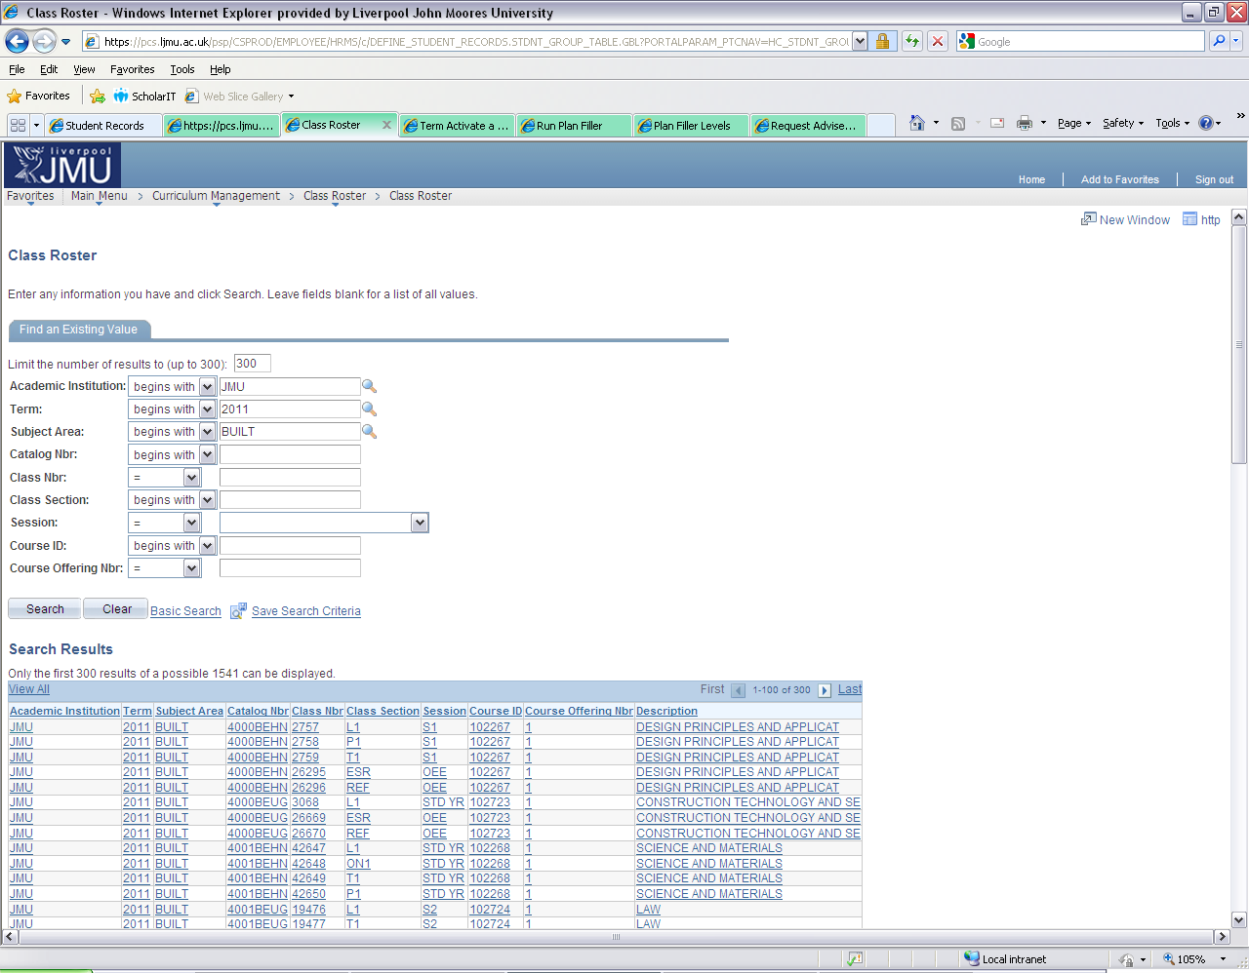

Slide 18
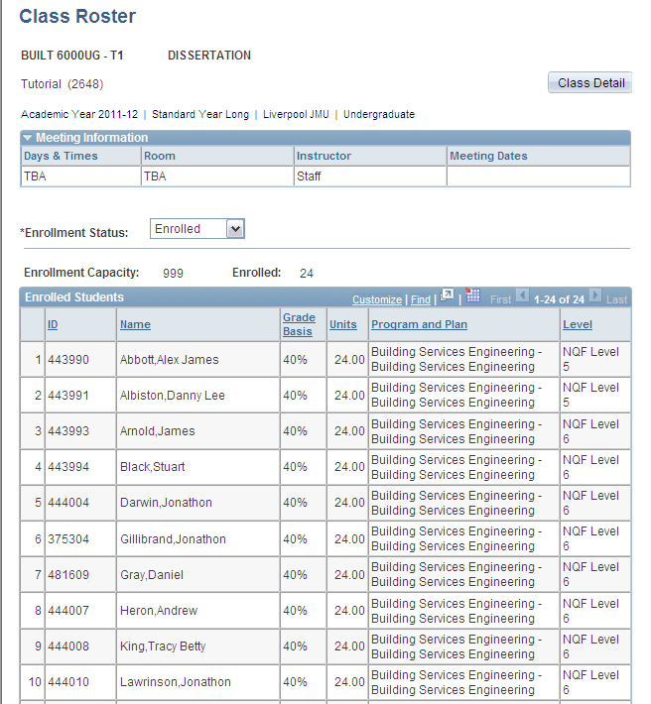

Slide 19
Student Information System
    Any Questions?

