Slide 1

Student Information System
Courses & Classes
Business Support Office

Slide 2
Introduction
Key Objectives:
  Understanding Courses
  Understanding Classes

Slide 3
Courses
What is a Course?
A Course is the system name for a Module
Courses are created in the Module Catalogue (ModCat) and are stored in the Course Catalogue

Slide 4
Courses
How is a Course constructed?
    Title
    Subject Area
    E.g. SPORDAN
Course Catalogue number
    E.g. 4012COACH
  First digit = Level

Slide 5
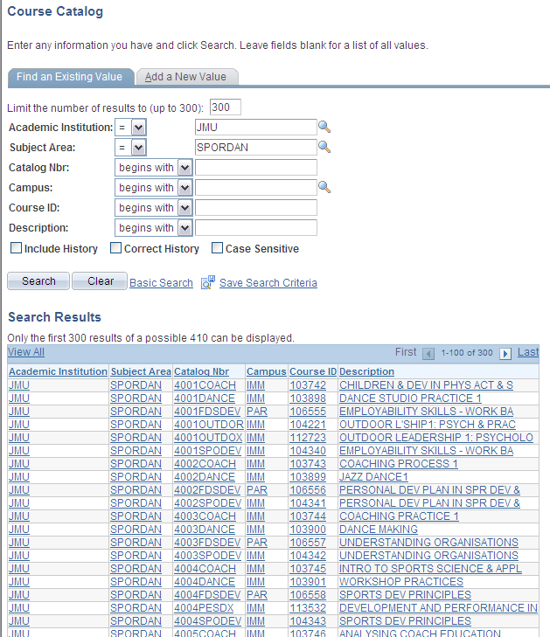
Courses

Slide 6
Courses
How is a Course constructed?
    Owning Details
    Components
  E.g. Lecture, Practical, Seminar, Tutorial, On/Off Site

Slide 7
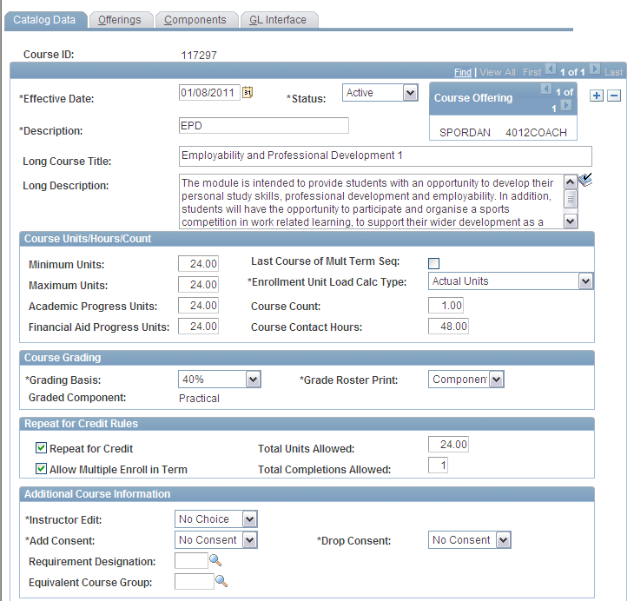
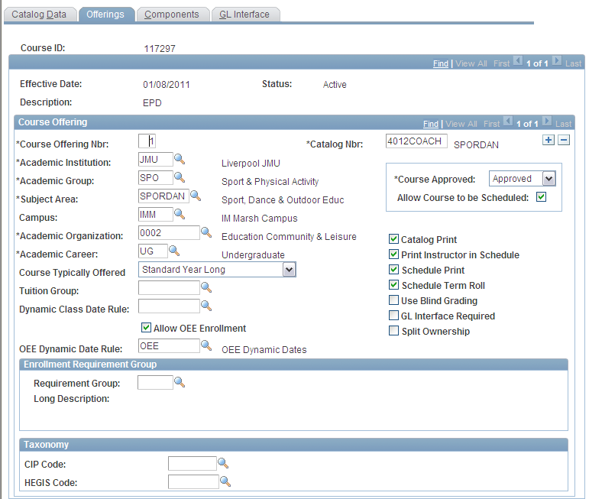
Courses

Slide 8
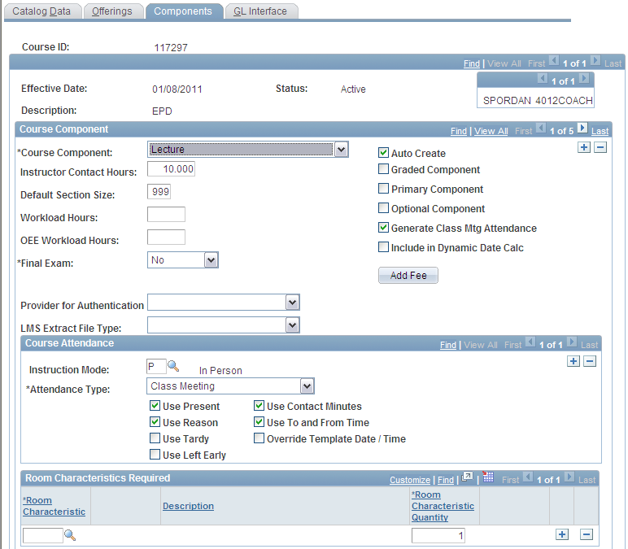
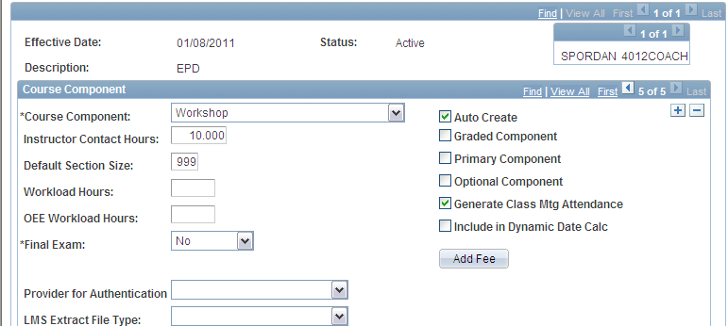
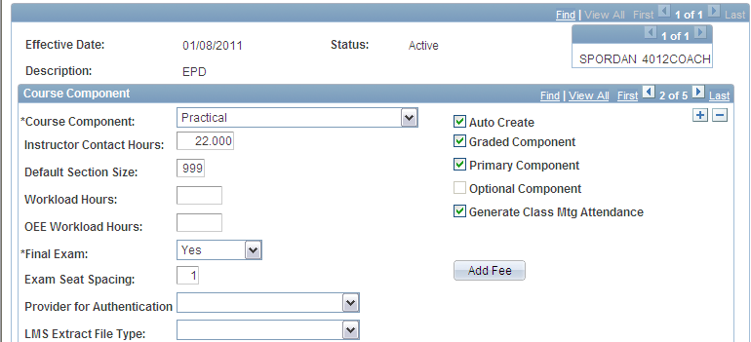



Slide 9
Transfer Credit & Courses
Where ‘blocks’ of Credit is being recorded
SIS uses its own set of Courses
This also includes a dedicated Subject Area and a Grade Basis

Slide 10
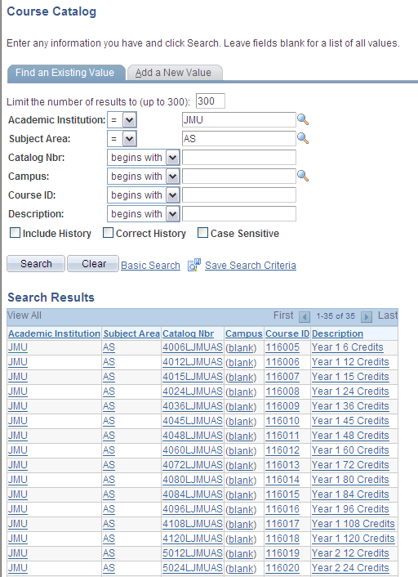

Slide 11
Student Information System
Important Note:
Where records have missed the OSS to SIS migration (for whatever reason) a new application needs to be entered by the Admissions Hub
Transfer Credit can then be entered for the ‘missing’ Academic History for the Programme – by module – not block credit!

Slide 12
Courses & Classes
Courses are Modules
Courses consist of Components
  = Teaching Delivery eg Lecture, Tutorial, Practical etc
Classes are scheduled Components
  For example:
  Lecture is on Monday at 10am
  Tutorial is on Thursday at 4pm
Students study on Classes

Slide 13
Student Information System
    Any Questions?

