Slide 1
Module 6:
Academic Misconduct
August 2011
Tracey Einig-Jones & Diane Taggart

Slide 2
Session Objectives
Brief Introduction to the LJMU Penalty Tariff
Recording Academic Misconduct Panel (AMP) Outcomes on SIS
  Service Indicators
  Student Records

Slide 3
The LJMU
Penalty Tariff
Standard penalty tariff to be used in all cases of proven academic misconduct from September 2011 to ensure fairness consistency to students across all Faculties
Ensures that all students are aware of the penalties that they will receive if they are found guilty of academic misconduct
Points are allocated following AMP based on various criteria

Slide 4
Penalty Tariff
POINTS | PENALTY
305 – 349 | Mark of 0 for assessment or module – student allowed to complete new piece of work, mark capped at minimum pass mark (e.g. 40%) for the assessment
350 – 479 | Mark of 0 for module – allowed to re-submit, module mark capped at the minimum pass mark e.g. 40%
480 – 524 | Mark of 0 no opportunity to resubmit the module
525 – 560+ | Case referred to Assessment Board to determine one of the following: Recommend expulsion with fallback award as appropriate Recommend expulsion with any fallback award withheld

Slide 5
Recording AMP Outcomes
SIS procedure uses a combination of:
Campus Community Service Indicators
Student Record activities
For each penalty band a different Service Indicator/Student Record combination is applied

Slide 6
Recording AMP Outcomes
Step One:
Service Indicators

Slide 7
Recording AMP Outcomes:
Service Indicators
Negative Service Indicator used to record the AMP outcomes
Applied as soon as the AMP decides points allocation
Remains permanently on the Students record and is viewable via self service communicating the penalty incurred
All staff can see Misconduct Indicator
Can only be applied by Student Policy & Regulation team and designated Faculty staff
Can only be released (via appeals process) by SPR
In some cases points incurred may be accompanied by Fitness to Practise referral

Slide 8
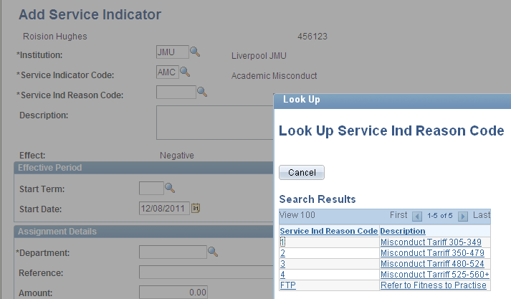
Recording AMP Outcomes:
Service Indicators

Slide 9
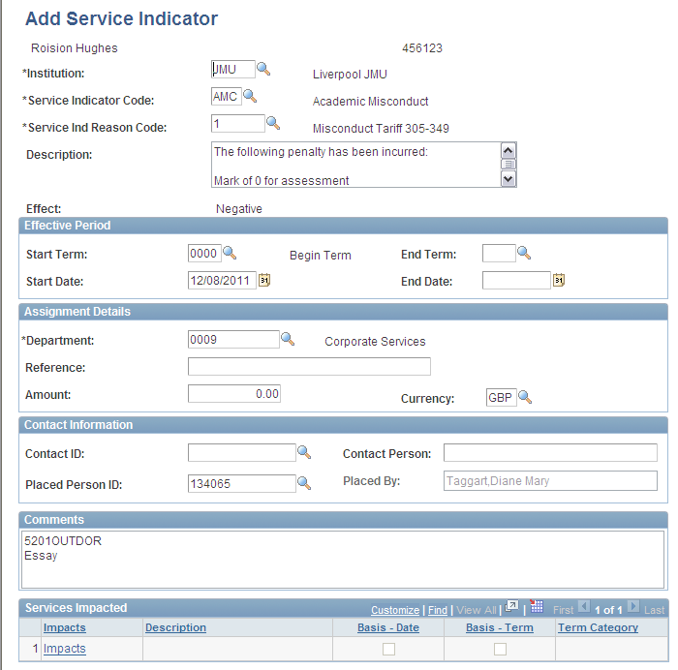
Recording AMP Outcomes:
Service Indicators

Slide 10
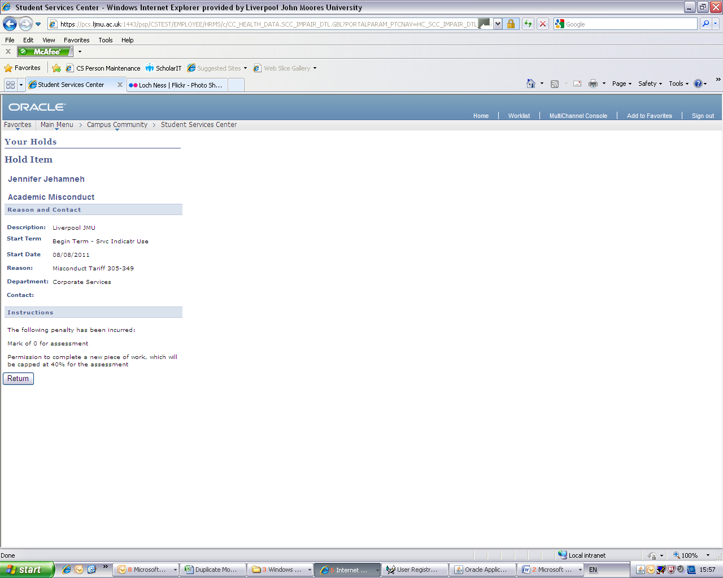
The Student View

Slide 11
Recording AMP Outcomes
Step Two
Student Record processes

Slide 12
Recording AMP Outcomes
305 – 349
Mark of 0 for assessment or module – student allowed to complete new piece of work, mark capped at minimum pass mark (e.g. 40%) for the assessment
Assignment Marks are amended in Gradebook
Is highlighted on the students record by way of a Transcript Note
Detailed in the Grading training session

Slide 13
Recording AMP Outcomes
350 – 479
Mark of 0 for module – allowed to re-submit, module mark capped at the minimum pass mark e.g. 40%
Grade of 0 is recorded on the Grade Roster
Student then enrolled on a Referral class in the normal way. This grade will be automatically capped at 40%
Is highlighted on the students record by way of a Transcript Note
Detailed in the Grading and Post Progression Training sessions

Slide 14
Recording AMP Outcomes
480 – 524
Mark of 0 no opportunity to resubmit
A Repeat Code is added to the latest course attempt
This prevents any further enrolment onto that course
Is highlighted on the students record by way of a Transcript Note
Detailed in the Post Progression training session

Slide 15
Recording AMP Outcomes
525 – 560+
Case referred to Assessment Board to determine one of the following:
Recommend expulsion with fallback award as appropriate
Recommend expulsion with any fallback award withheld
Apply a Plan change (if Fallback is to be awarded)
Complete the student
Student Zone then discontinues the student
Detailed in Completion Training Session

Slide 16
Recording AMP Outcomes
Any Questions?

Slide 17
End of Presentation
Points Tariff questions – Please contact Marie Ward M.Ward@ljmu.ac.uk
SIS Processes – Helpdesk Mail
Time for UPK Session…

