Slide 1

Student Information System
Academic Advisement Verification Process August 2011

Slide 2
Introduction
Key Objectives:
  Understanding related processes
  Understanding Academic Advisement set up
  Understanding AA & Student Records
  Understanding AA & LJMU
  Understanding AA Reports

Slide 3
Programme and Courses
Academic Structure
Academic Advisement
Student Data
New Module
Institution
Careers
Programme
Plan
Course Catalogue
Career
Programme
Plan
NQF4
Course 1 Core
Course 2 Core
Course 3 Core
Course 4 Core
Course 5 Core
Course 6 Core
NQF5
Course 1 Core
Course 2 Core
Course 3 Core
Course 4 Core
Course 5 Option
Course 6 Option
NQF6
Course 1 Core
Course 2 Core
Course 3 Option
Course 4 Option
Course 5 Option
Course 6 Option
Active on Career
Programme
Plan
Module Catalogue
Student Advisement Report
Validated & Approved
Enrolled on Classes
Programme Catalogue
Within SIS
New Programme/Plan
Outside SIS
Notes:
Only the information held in PRODCAT and MODCAT will or can be entered into SIS
Modules need to be at DEFN status before the module is available within SIS to be used in AA

Slide 4
Academic Advisement
A module within SIS that allows us to store and use:
The validated Programme content as defined in the Programme Specification (PRODCAT)
Only Programmes that are officially validated (approved) are available for students to study
Only modules that are officially validated (approved) are available for students to study
These modules can then be listed as part of the validated programme

Slide 5
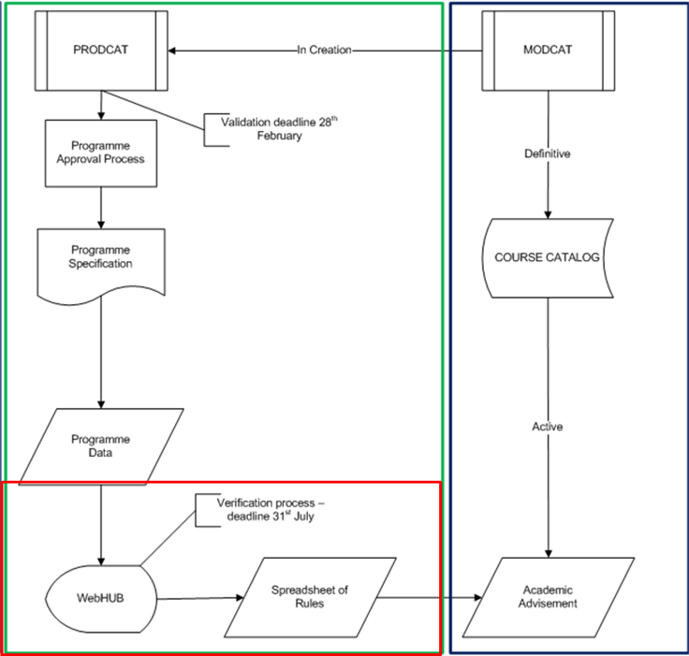

Slide 6
Academic Advisement
Example AA Set up
Programme Rule: 360 credits to be achieved
Level Rules: 3 Levels
120 credits to be achieved in each level
Core/Option credit split
Course Rules: Core lists
Option lists
Groups of options (and/or)

Slide 7
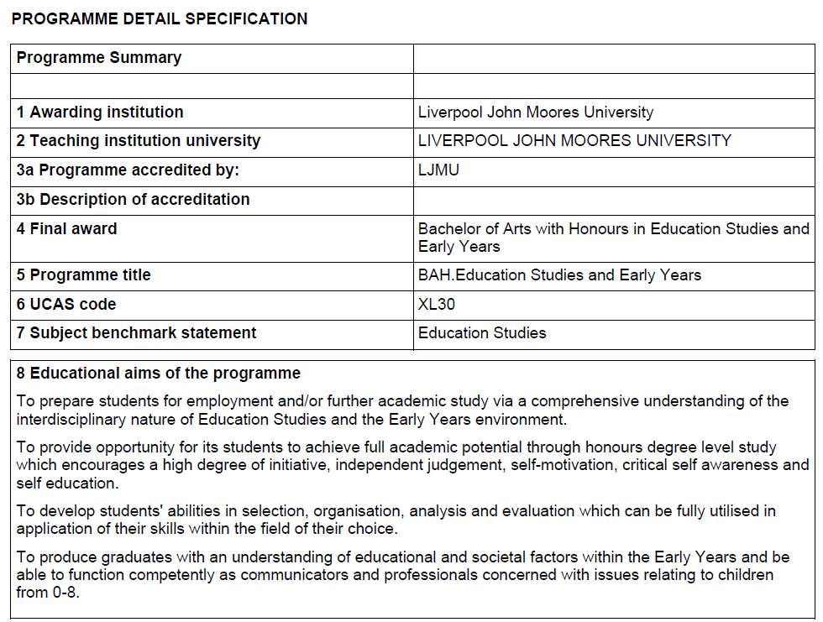
Academic Advisement

Slide 8
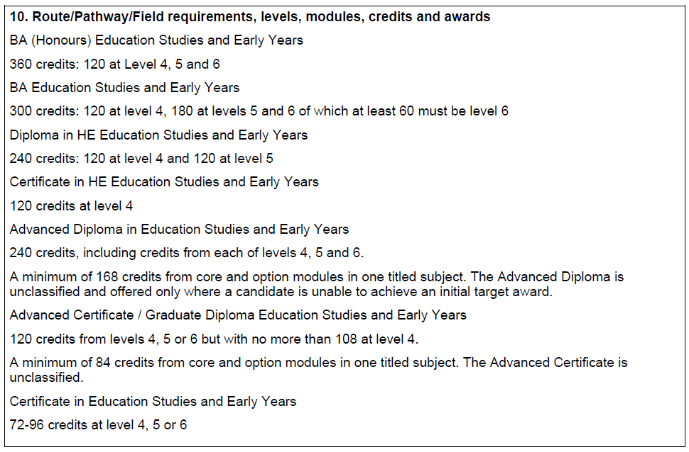
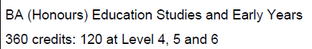
Academic Advisement

Slide 9
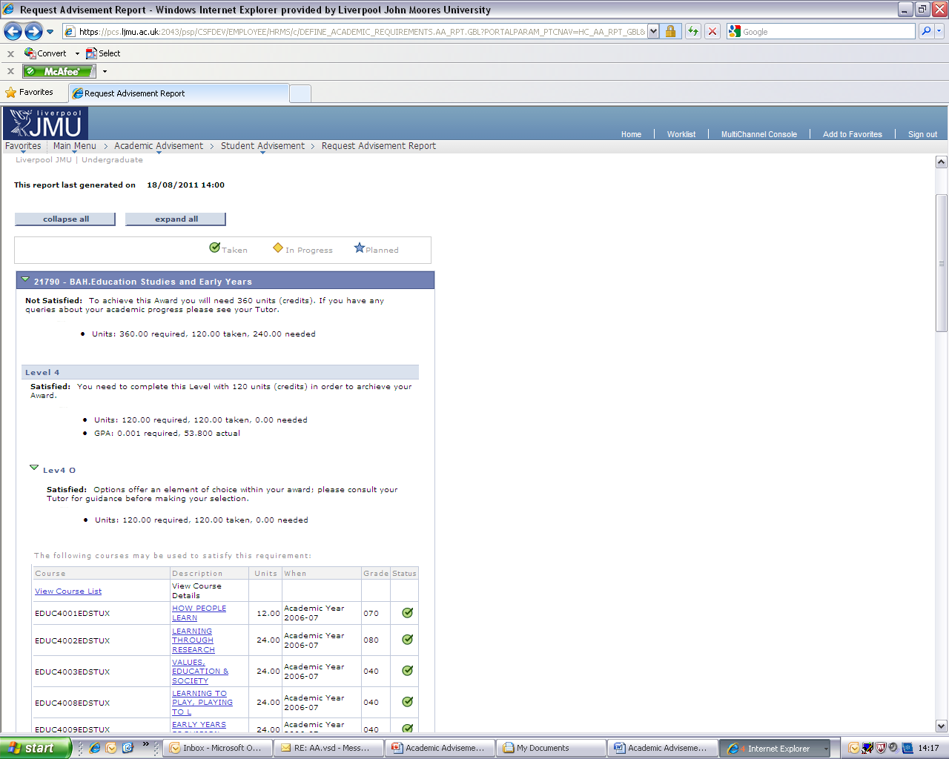
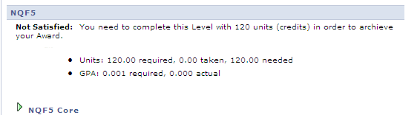
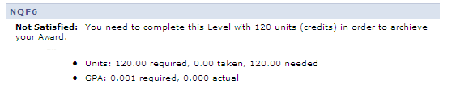
Academic Advisement

Slide 10
Academic Advisement
Academic Advisement uses both the Programme and Module data…
And the programme rules
To give us a structure in SIS that enables staff and students to understand how their programme is structured
and is used to correctly inform enrolment, progression and Plan by Requirements (OMS)

Slide 11
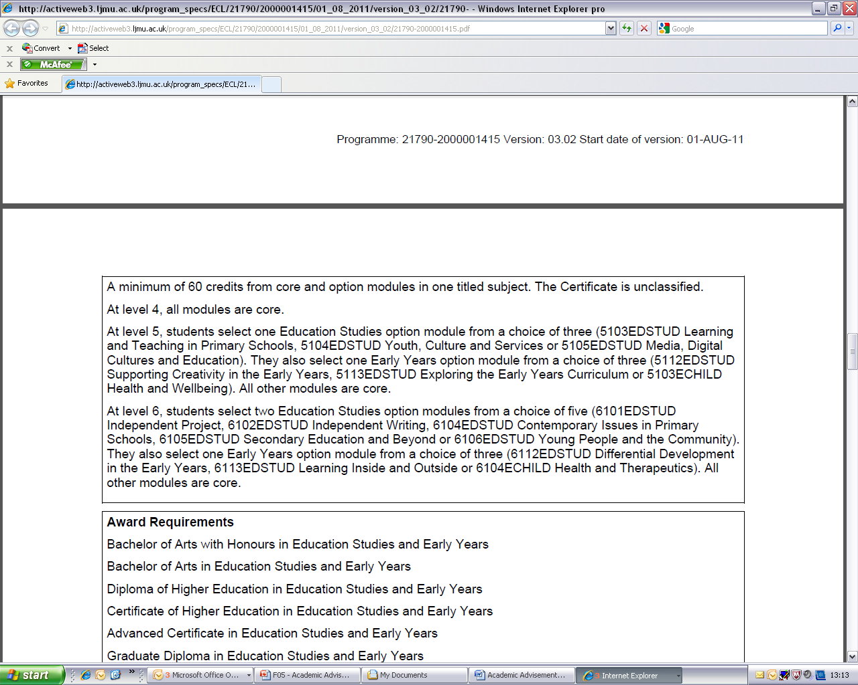
Academic Advisement

Slide 12
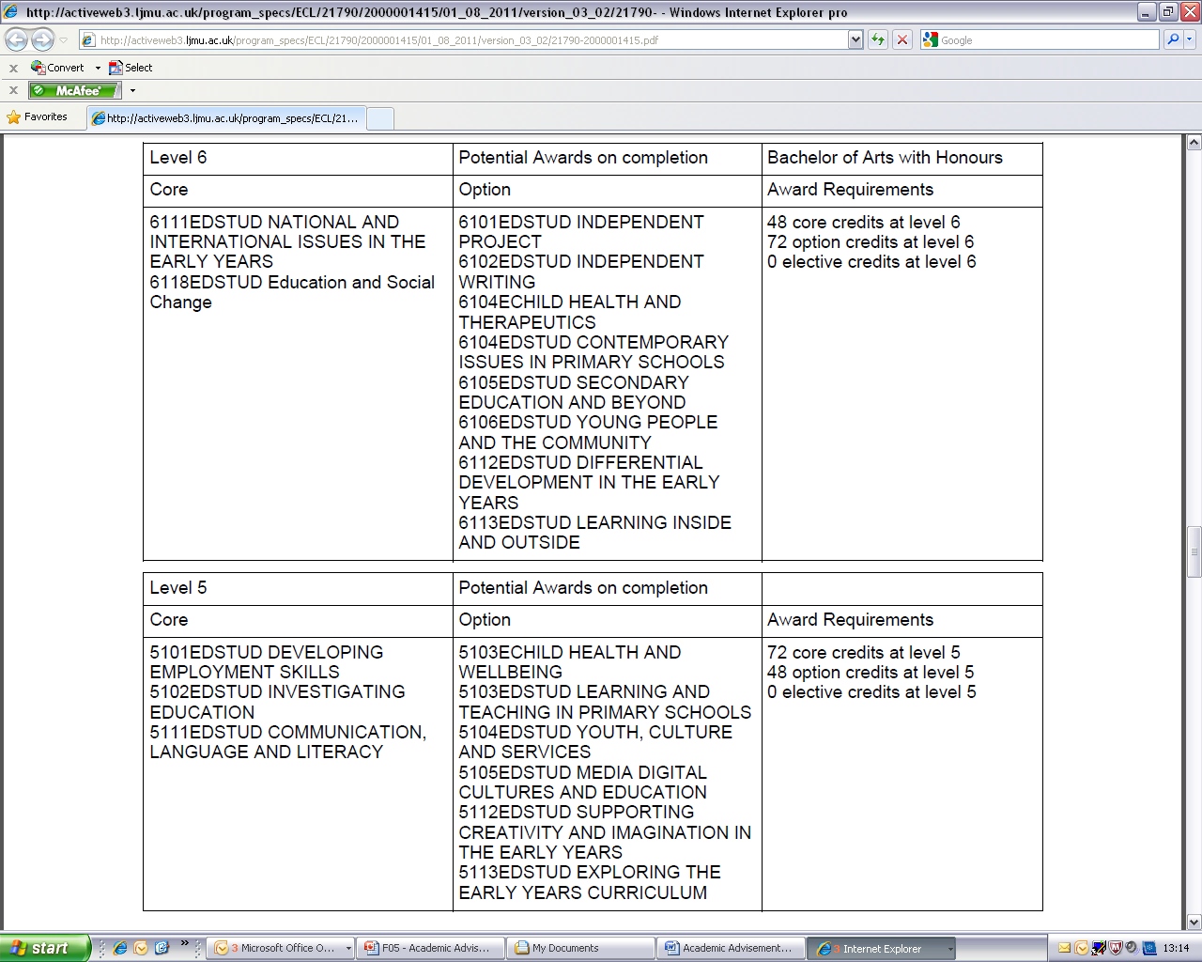
Academic Advisement

Slide 13
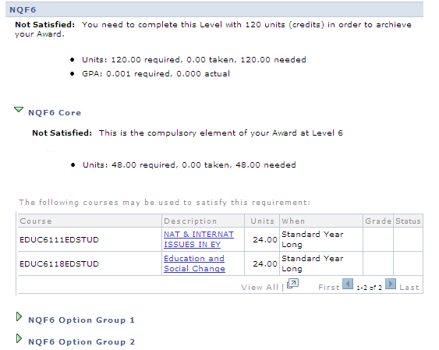
Academic Advisement

Slide 14
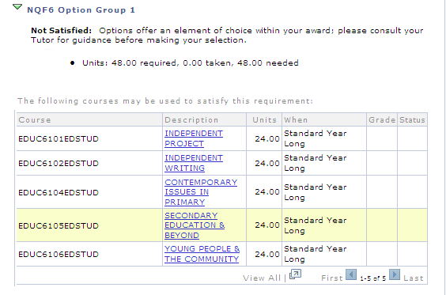
Academic Advisement

Slide 15
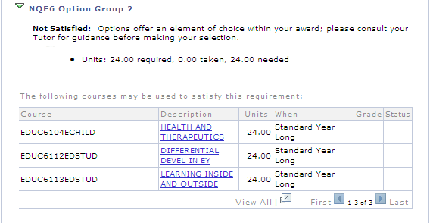
Academic Advisement

Slide 16
Academic Advisement
Plan By Requirements
Enrolment
Progression

Slide 17
Academic Advisement
The programme, module and rule data is then combined with student data –
Student Career
Student Programme
Student Plan
Student Requirement Term
Student Courses
The result of which is an Advisement Report

Slide 18
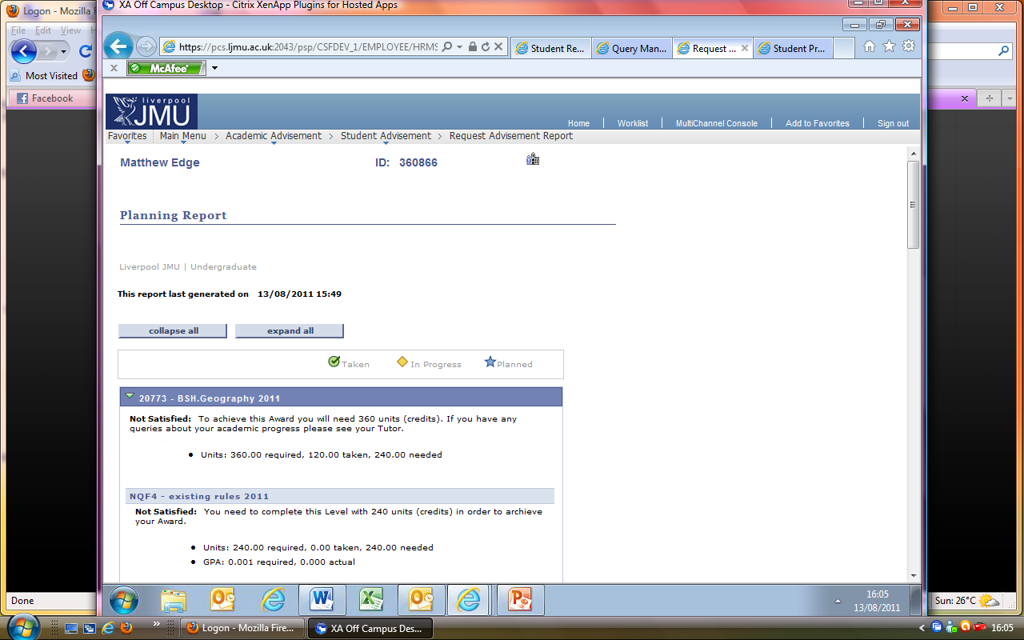
Academic Advisement
There are 2 types of Advisement Report in SIS
The Academic Advisement Report – AAR
The Planning Report – Plan
Both reports use the same data
But display it in different ways

Slide 19
Planning Report
The Planning Report shows student and staff which Courses –
Are available to study in the next year and level
Have been selected as part of OMS (planned to study)
Are currently enrolled (not yet graded)

Slide 20
Planning Report
The Planning Report facilitates:
Students being able to select which options they would like to study in their next year
Staff to see those selections (Verification)
Students and staff ensuring that the correct courses are enrolled upon

Slide 21
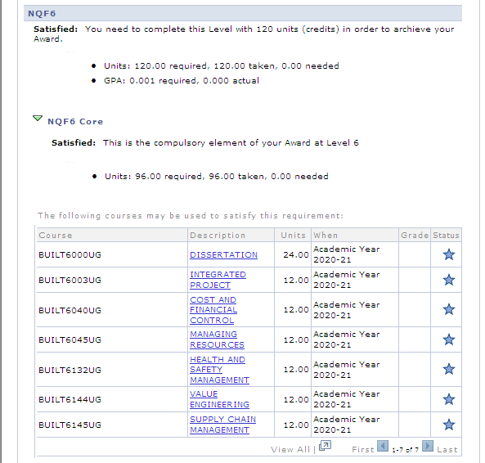

Slide 22
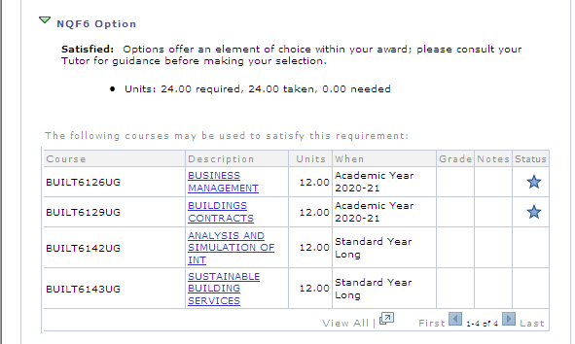

Slide 23
Academic Advisement
Programme ‘Versions’
Programme Rules often change (from year to year)
SIS uses Effective dated rows in Advisement to store these changes
The PLN team with your help have created new Effective Dated Rows for 01-08-2011 for all your validated programmes and modules

Slide 24
Academic Advisement
This means that New students (from August 2011)
Will only ‘see’ these newly defined rules in their advisement reports
This is controlled by the Requirement Term assigned on the students programme/plan stack

Slide 25
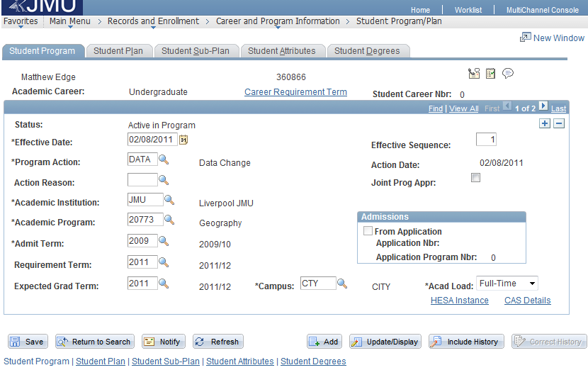
Academic Advisement

Slide 26
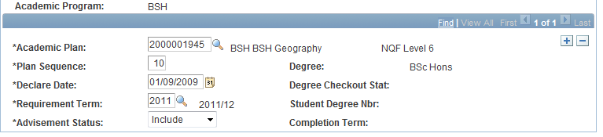
Academic Advisement
In addition to the Programme Requirement Term, there is also a Plan Requirement Term
This is because the plan is the Award Aim!
If a student changes between rules both Requirement Terms need to be changed

Slide 27
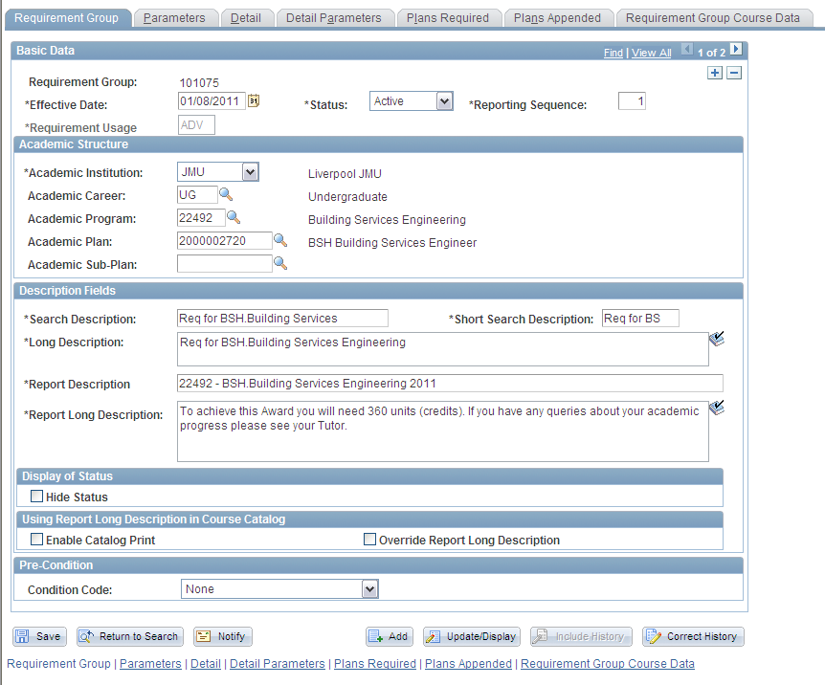

Slide 28
Academic Advisement
The 2011 rule set applies from Aug 2011 forwards
What happens to continuing students that have previous years of study?
To solve this problem we have created ‘Global Rules’
Global rules look at any module that has been studied at any point (up to 2011) and count it towards the students progression

Slide 29
Academic Advisement
The ‘global’ rule checks for the number of credits a student has achieved at each level – literally,
‘Has the student achieved 120 credits at NQF Level 4?’
This is similar to the Non Standard PAB process in OSS as agreed by SIMG

Slide 30
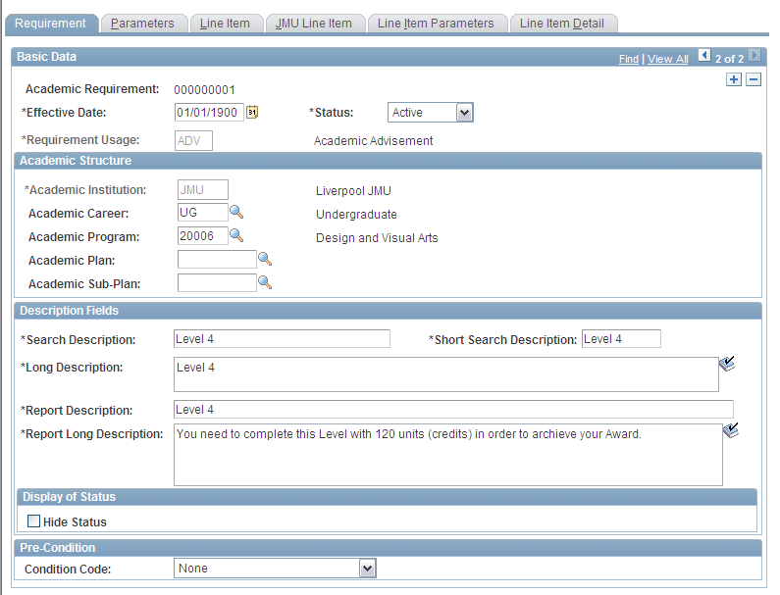
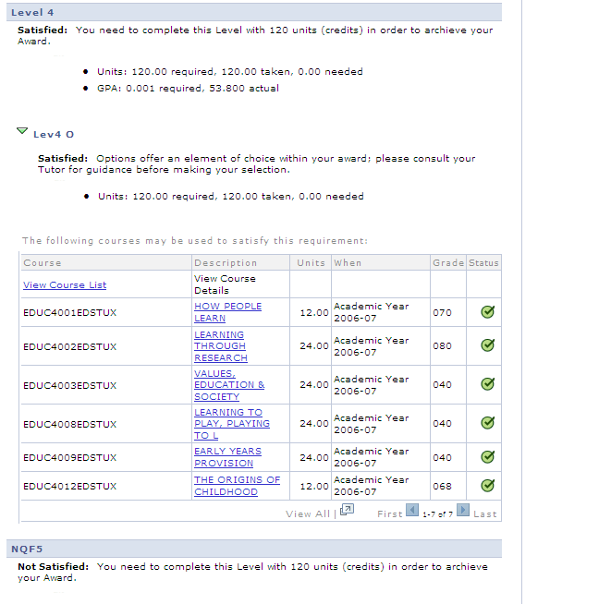

Slide 31
Academic Advisement
The 2011 rules should apply to ALL students, new and continuing, from 2011 onwards.
However, where continuing students need to study a different set of courses from new students from 2011 - a different set of advisement rules needed to be created.

Slide 32
Academic Advisement
To differentiate these rules from the 2011 and the global, they have been labelled 2010.
The continuing students’ requirement terms need to be set to 2010

Slide 33
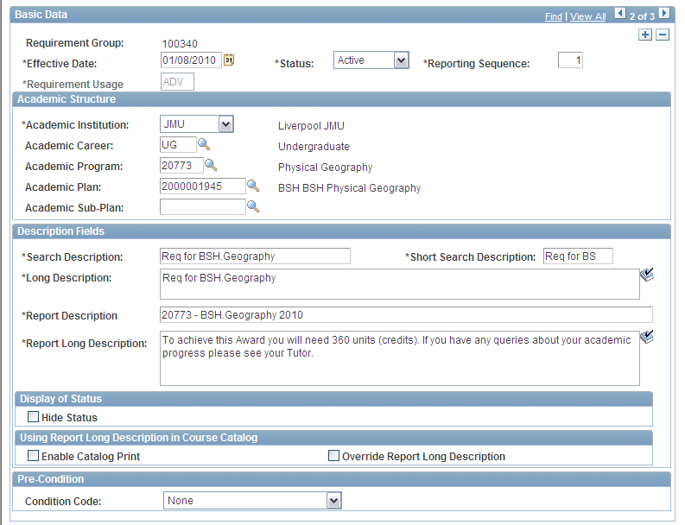

Slide 34
Next Steps
Check your Programme and Plan set up is correct
- SECTION 3 - green
That migrated student data is correct
- SECTION 3 - blue
That OMS selections are correct
- SECTION 3 - purple
Start using SIS, familiarising yourself with the terminology and the data!

Slide 35
Next Steps – How?
Nominate one or two members of staff who KNOW your programmes and are familiar with PRODCAT and your student records
Make them available to work with staff in PLN and the CS team to check programme and student records as per the instructions
WEDNESDAY 24TH AUGUST – IT SUITE, 2ND FLOOR, JOHN FOSTER BUILDING – ACADEMIC ADVISEMENT VERIFICATION MASTERCLASS
We will provide reports – programmes, plans and student records to check
You will provide enthusiastic & willing staff – please!
If you do – we will also provide expertise and lots of tea, coffee and BISCUITS!
Data must be verified prior to enrolling the students on their 2011 classes

Slide 36
Academic Advisement
Any Questions?

