Slide 1

Student Information System
Academic Advisement
An Introduction
Business Support Office

Slide 2
Introduction
Key Objectives:
  Understanding Academic Advisement set up
  Understanding AA & Student Records
  Understanding AA Reports
  UPK Session

Slide 3
Academic Advisement
Academic Advisement is an area within SIS that allows us to store and use:
The validated Programme content as defined in the Programme proforma

Slide 4
Programme and Courses
Academic Structure
Academic Advisement
Student Data
New Module
Institution
Careers
Programme
Plan
Course Catalogue
Career
Programme
Plan
NQF4
Course 1 Core
Course 2 Core
Course 3 Core
Course 4 Core
Course 5 Core
Course 6 Core
NQF5
Course 1 Core
Course 2 Core
Course 3 Core
Course 4 Core
Course 5 Option
Course 6 Option
NQF6
Course 1 Core
Course 2 Core
Course 3 Option
Course 4 Option
Course 5 Option
Course 6 Option
Active on Career
Programme
Plan
Module Catalogue
Student Advisement Report
Validated & Approved
Enrolled on Classes
Programme Catalogue
Within SIS
New Programme/Plan
Outside SIS

Slide 5
Product Catalogue
Module Catalogue
Is a database (part of SIS) that is used as an area to create, store and view LJMU Modules documentation
Only modules that are officially validated (approved) are available for students to study
These modules can then be listed as part of the validated programme

Slide 6
Product Catalogue
Programme Catalogue
Is a database (external to SIS) that is used as an area to create, store and view LJMU Programme documentation
Only Programmes that are officially validated (approved) are then available for students to study

Slide 7
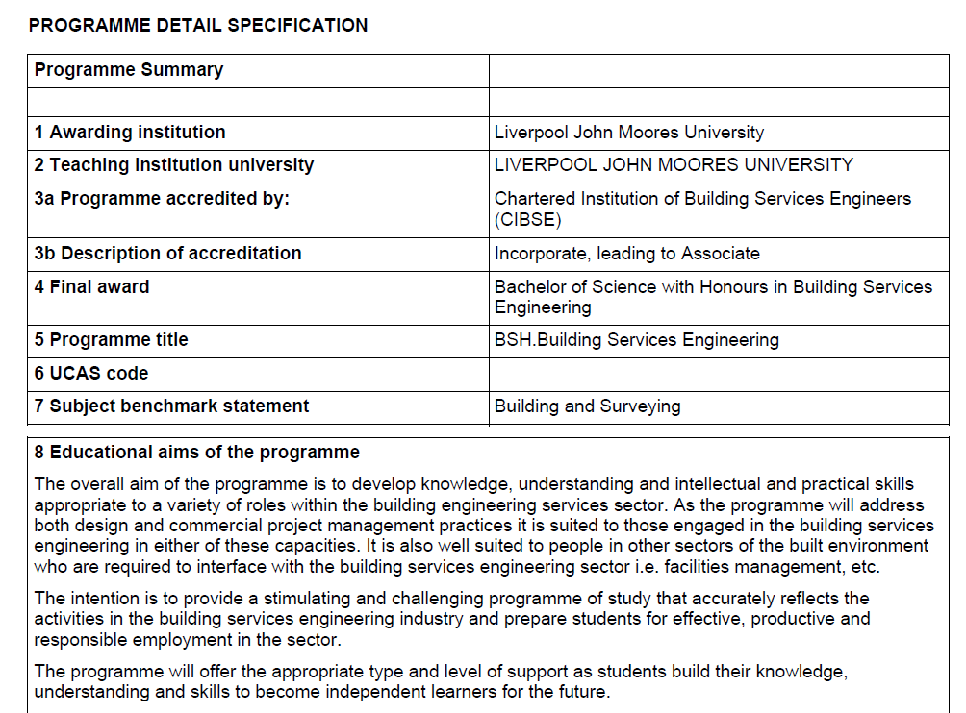
Programme Proforma

Slide 8
Academic Advisement
Academic Advisement uses both the Programme and Module data…
And the programme rules
To give us a structure in SIS that enables staff and students to understand how their programme is structured
and is used to correctly inform enrolment, progression and Plan by Requirements (OMS)

Slide 9
Academic Advisement
Plan By Requirements
Enrolment
Progression

Slide 10
Academic Advisement
Example AA Set up
Programme Rule: 360 credits to be achieved
Level Rules: 3 Levels
120 credits to be achieved in each level
Core/Option credit split
Course Rules: Core lists
Option lists
Groups of options (and/or)

Slide 11
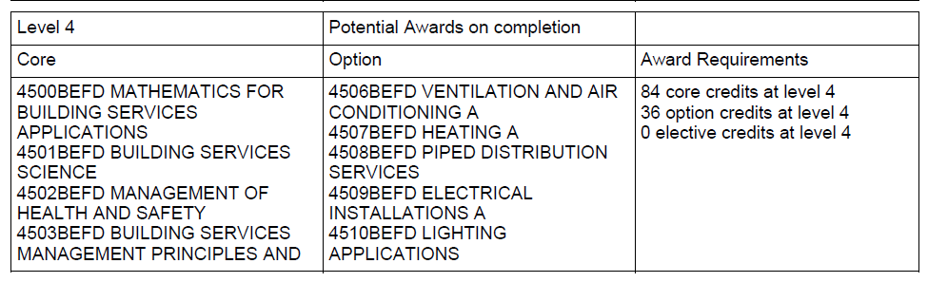
Academic Advisement
For example the above profoma for BSH BSE tells us:
“The programme adheres to the University Modular Framework with 360 credits needed to achieve the BSc Honours award in Building Services Engineering. 240 credits will be attained on the FDSc in Building Services Engineering or equivalent and 120 credits will be at level 3 and will combine core and optional modules. The optional modules that will be taken by the student will be dependent on their chosen subject specialism.”
And which modules should be used in each Level as well as the type of module:

Slide 12
Academic Advisement
The programme, module and rule data is then combined with student data –
Student Career
Student Programme
Student Plan
Student Requirement Term
Student Courses
The result of which is an Advisement Report

Slide 13
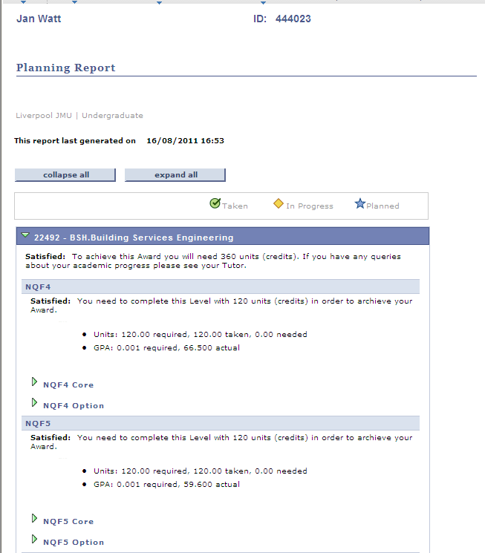

Slide 14
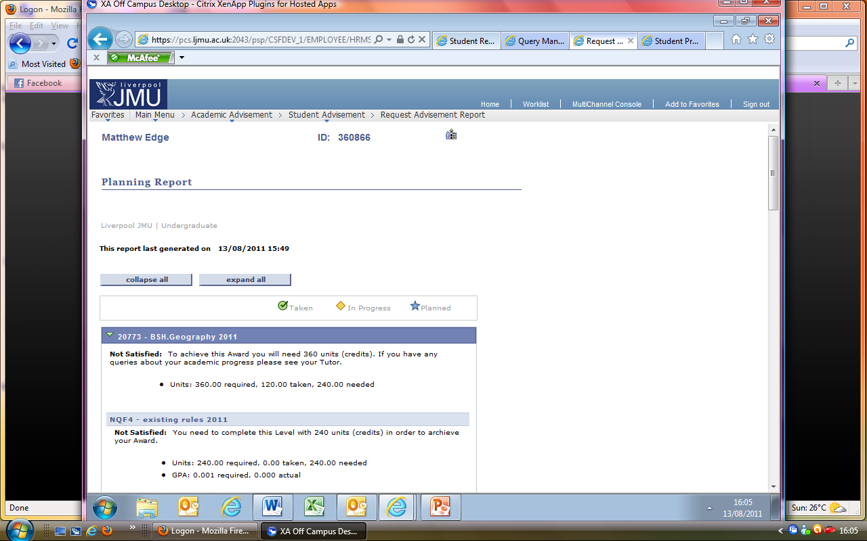
Academic Advisement
There are 2 types of Advisement Report in SIS
The Academic Advisement Report – AAR
The Planning Report – Plan
Both reports use the same data
But display it in different ways

Slide 15
Planning Report
The Planning Report shows student and staff which Courses –
Are available to study in the next year and level
Have been selected as part of OMS (planned to study)
Are currently enrolled (not yet graded)

Slide 16
Planning Report
The Planning Report facilitates:
Students being able to select which options they would like to study in their next year
Staff to see those selections (Verification)
Students and staff ensuring that the correct courses are enrolled upon

Slide 17
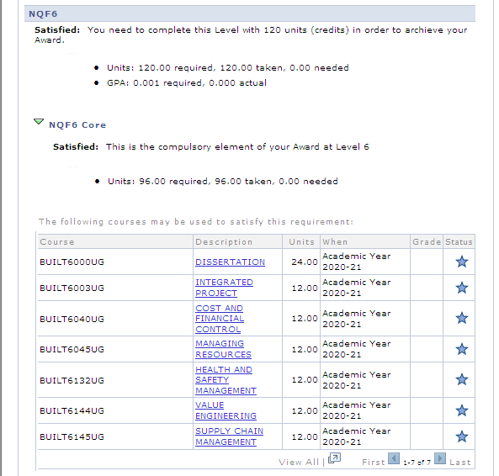

Slide 18
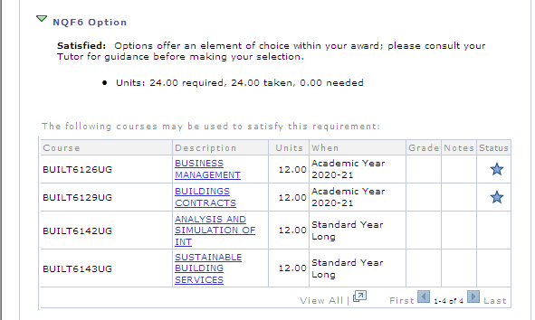

Slide 19
AAR
The Academic Advisement Report shows students and staff which Courses –
Have been graded, posted (finalised) and successfully passed

Slide 20
AAR
The AAR also shows students and staff -
What the student progress is towards their chosen Programme and Plan (named award)
What their current Grade Point Average is (Level Mean Mark)

Slide 21
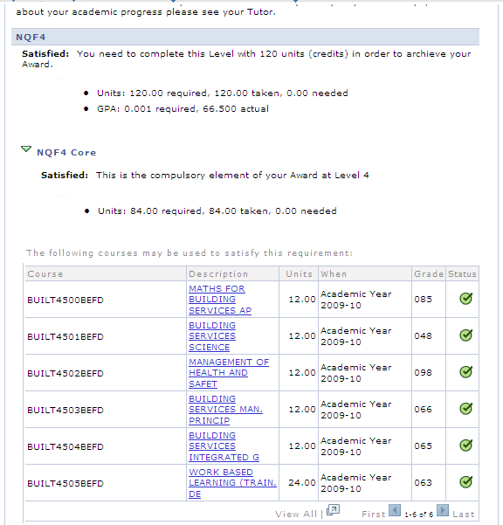

Slide 22
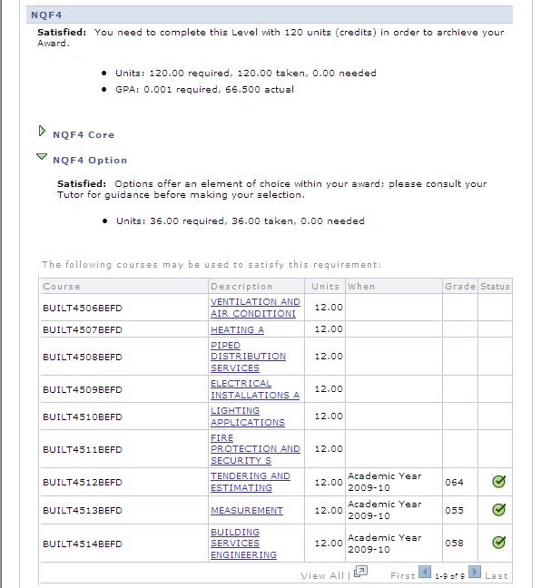

Slide 23
Academic Advisement
Programme ‘Versions’
Programme Rules often change (from year to year)
SIS uses Effective dated rows in Advisement to store these changes
The PLN team with your help have created new Effective Dated Rows for 01-08-2011 for all your validated programmes and modules

Slide 24
Academic Advisement
This means that New students (from August 2011)
Will only ‘see’ these newly defined rules in their advisement reports
This is controlled by the Requirement Term assigned on the students programme/plan stack

Slide 25
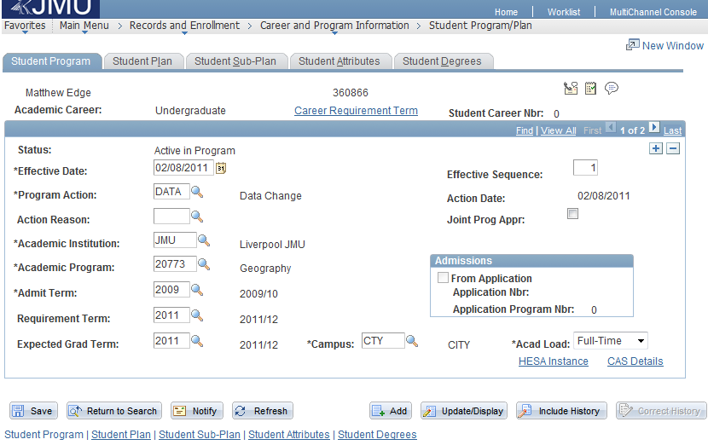
Academic Advisement

Slide 26
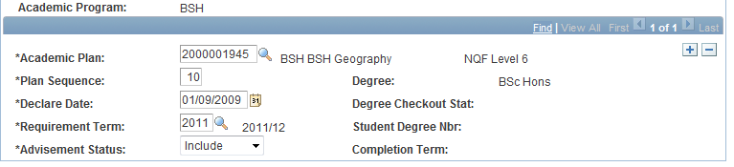
Academic Advisement
In addition to the Programme Requirement Term, there is also a Plan Requirement Term
This is because the plan is the Award Aim!
If a student changes between rules both Requirement Terms need to be changed

Slide 27
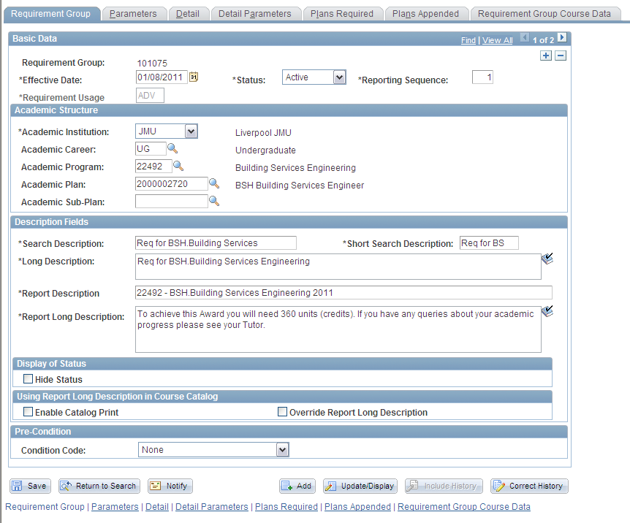

Slide 28
Academic Advisement
The 2011 rule set applies from Aug 2011 forwards
What happens to continuing students that have previous years of study?
To solve this problem we have created ‘Global Rules’
Global rules look at any module that has been studied at any point (up to 2011) and count it towards the students progression

Slide 29
Academic Advisement
The ‘global’ rule checks for the number of credits a student has achieved at each level – literally,
‘Has the student achieved 120 credits at NQF Level 4?’
This is similar to the Non Standard PAB process in OSS as agreed by SIMG

Slide 30
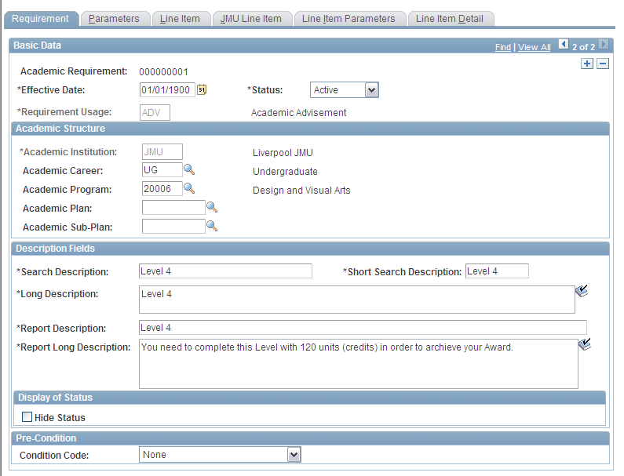

Slide 31
Academic Advisement
The 2011 rules should apply to ALL students, new and continuing, from 2011 onwards.
However, where continuing students need to study a different set of courses from new students from 2011 - a different set of advisement rules needed to be created.

Slide 32
Academic Advisement
To differentiate these rules from the 2011 and the global, they have been labelled 2010.
The continuing students’ requirement terms need to be set to 2010

Slide 33
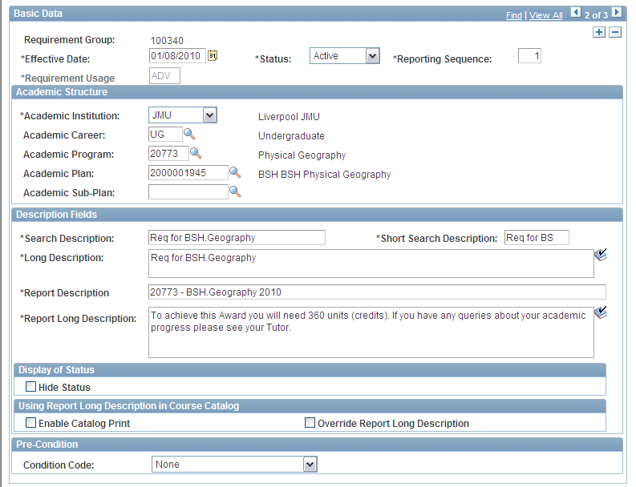

Slide 34
Next Steps
The SIS team will shortly release the Plan Report to Faculties. This will enable you to:
Check your Programme and Plan set up is correct
That migrated student data is correct
That OMS selections are correct
Get used to the functionality and what you are seeing

Slide 35
Next Steps
Once your training is complete and you have access to SIS:
You’ll be able to ‘move’ students between Requirement Terms as necessary
Use a Effected Dated row of DATA (data change) on the students programme/plan stack
Don’t forget to change both the Programme and Plan Requirement Terms

Slide 36
Academic Advisement
Any Questions?

