Slide 1



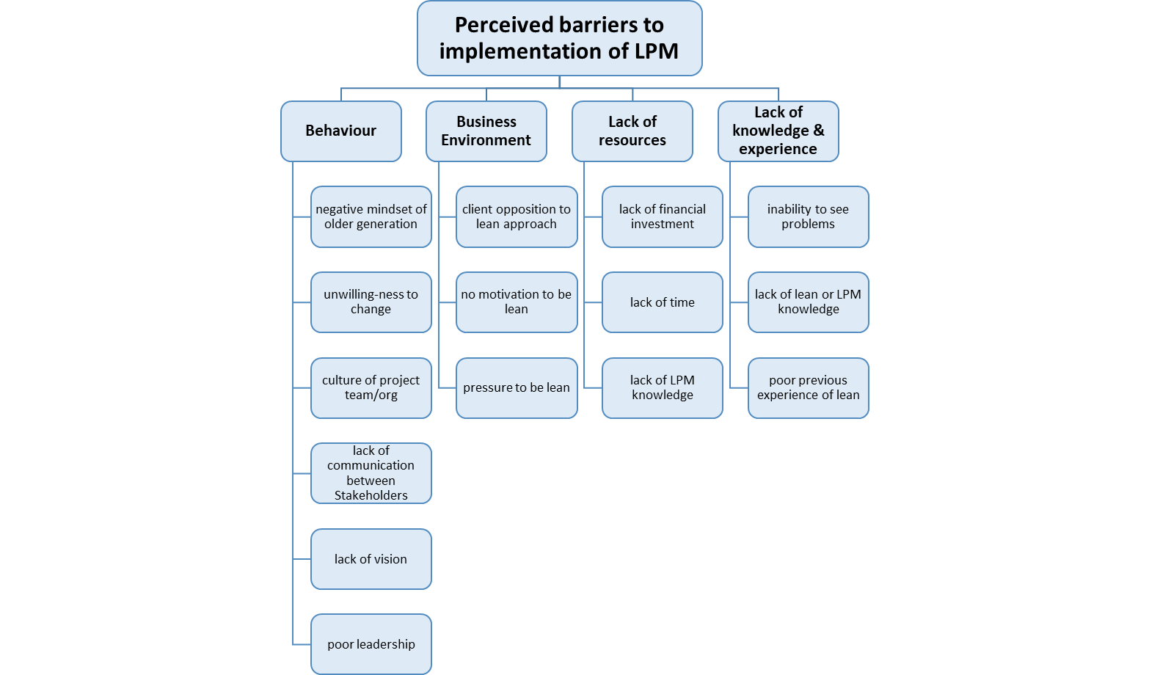
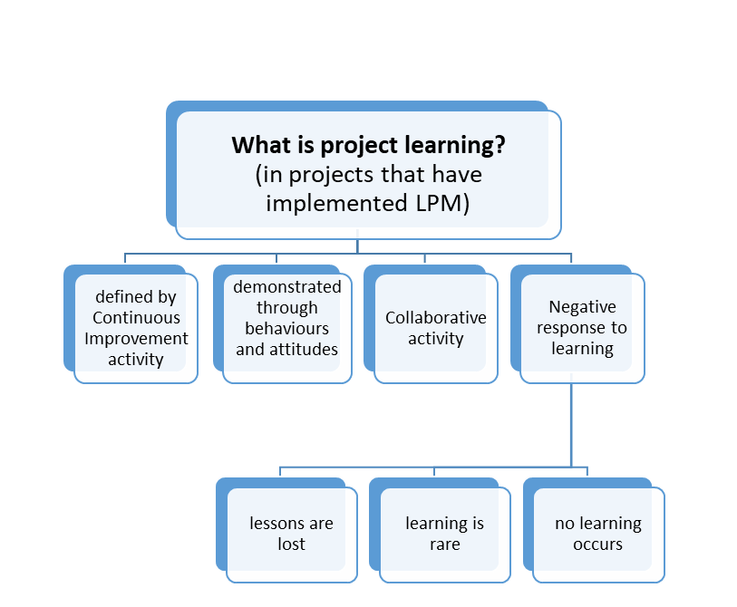
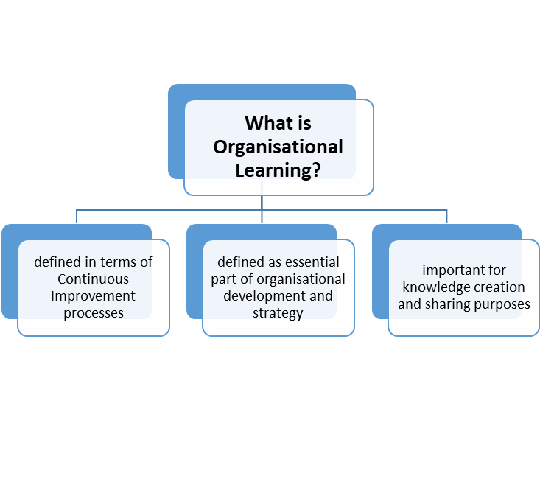

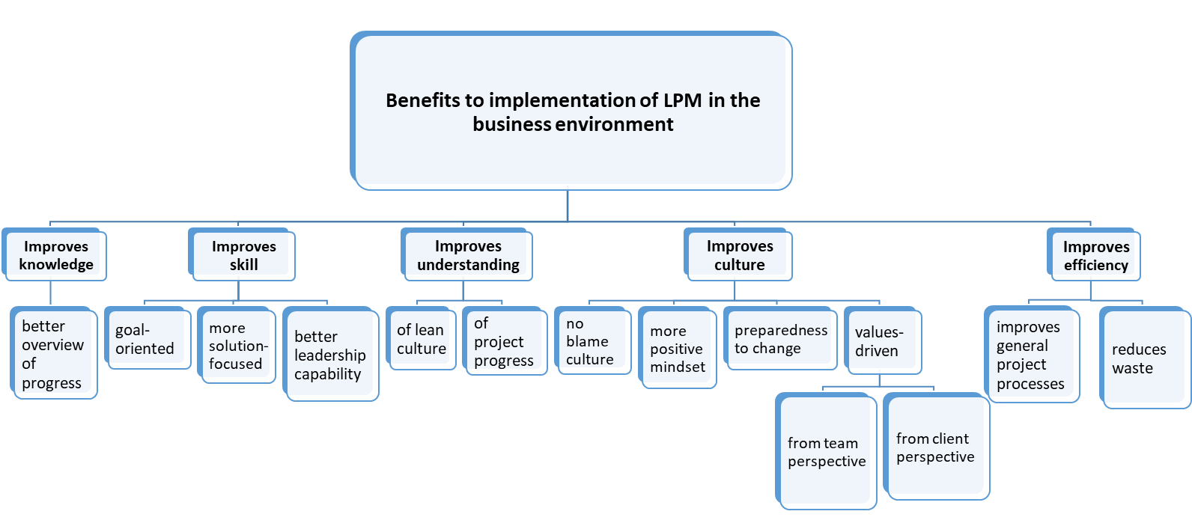
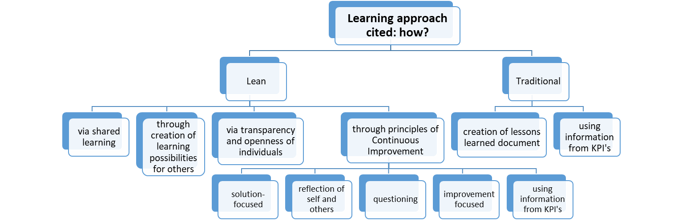
Jane Dowson j.dowson@ljmu.ac.uk
An exploratory study of the relationship between Lean Project Management and Organisational Learning
The Research Problem
Methods
Despite increased knowledge and extensive experience of certified PMP’s, disparities still remain between PM knowledge and stakeholder satisfaction.¹ Complexities exist within and across project boundaries and business environments, challenging project performance, creating a demand for timely and appropriate responses.² Lack of insight into what causes complexity can have an undesirable effect upon knowledge interpretation, sharing and learning processes, preventing time-bound appropriate responses to problem signs.^{3,4,5}
The utility and impact of lean principles remains a point of contention⁶ and few attempts have been made to link lean project management with overall learning and knowledge success from an outcome-driven behavioural perspective^{7,8} focusing on highlighting singular process-related, task-driven systems and improving operational procedures only.^{9,10}
Thus, important insight may be gained from exploration of the relationship between lean project management and organisational learning to facilitate improved project performance and provide PM practitioners with increased understanding and guidance.¹¹
Qualitative research methodology using inductive and interpretative approach,¹² including collection of multiple sources of evidence suited to cross-verify and validate findings,^{13,14} analysed thematically¹⁵ to create a framework to illustrate the relationship between LPM and OL.
Progress & Achievements
At December 2018:
Semi-structured interviews with Lean Project Managers (multi-disciplinary) undertaken (n=33/40)
Case study project underway (n=1), with 4/6 non-participant observation episodes and 3 project stakeholder interviews completed
Initial analysis via Nvivo supports creation and development of 3 emerging themes:
Theme 1: Knowledge & Understanding of LPM
Theme 2: Implementation of LPM: perceived barriers & benefits
Theme 3: Perceptions and mechanisms of Learning: Project and Organisational Learning
Research & Practitioner Implications:
PM’s may make informed choices about LPM role and knowledge utilisation
May facilitate better management of the limited resources available
May potentiate improvements in capacity for knowledge and future OL for project and organisational success.
1. Cicmil, S., & Hodgson, D. (2006) New possibilities for project management theory: a critical engagement, Project Management Journal, 37 (3), 111-122; 2. Whittingham, I. (2017) The Emergence of Complexity, PMI, via https://www.projectmanagement.com/articles/383994/The-Emergence-of-Complexity; 3. Söderlund, J. (2011) Pluralism in Project Management: Navigating the Crossroads of Specialization and Fragmentation, International Journal of Management Reviews, 13, 153-176; 4. Haji-Kazemi, S., Andersen, B., & Klakegg, O. J. (2015) Barriers against effective responses to early warning signs in projects, International Journal of Project Management, 33, 1068-1083; 5. Williams, T., Klakegg, O., Andersen, B., Walker, D., Magnussen, O., & Onsoyen, L. (2010) Early warning signs on complex projects, in Syed, G.A. (2016) An Interpretive Framework for Complexity in IT Projects, PhD thesis, University of Technology Sydney, Australia, 2015, via https://opus.lib.uts.edu.au/handle/10453/43473 ; 6. Staats, B.R., Brunner, D.J., & Upton, D.M. (2011) Lean principles, learning and knowledge work: Evidence from a software services provider, Journal of Operations Management, 29, 376-390; 7. Hines, P., Holwe, M., & Rich, N. (2004) Learning to evolve: a review of contemporary lean thinking, International Journal of Operations & Production Management, 24 (10), 994-1011; 8. Nidumolu, S.R., & Subramani, M.R. (2003) Combining process and structure approaches to managing software development, in Staats, B.R., Brunner, D.J., & Upton, D.M. (2011) Lean principles, learning and knowledge work: Evidence from a software services provider, Journal of Operations Management, 29, 376-390; 9. Spear, S. (2005) Fixing health from the inside, today, Harvard Business Review, 83 (9), 78-91; 10. Poksinska, B. (2010) The Current State of Lean Implementation in Health Care: Literature Review, Quality Management in Health Care, 19 (4) 319-329; 11. Thomas, J., & Mengel, T. (2008) Preparing project managers to deal with complexity – advanced project management education, International Journal of Project Management, 26, 204-315; 12. Williams, M., & May, T. (1996) Introduction to the philosophy of social research, London: UCL; 13. Stake, R, E (1995) The Art of Case Study Research, Thousand Oaks, CA: Sage; 14. Yin, R. K. (2014) Case Study Research: Design & Methods, 5th ed. Thousand Oaks, CA: Sage; 15. Braun, V. & Clarke, V. (2006) Using thematic analysis in psychology, Qualitative Research in Psychology, 3 (2), 77-101

